Slide 1


Introduction to 16S rRNA amplicon sequencing SAGE II | 24.03.23 | Daniel Garrido Sanz

Slide 2
Contents
Background
Metagenomics
Targeted vs. shotgun
16S rRNA amplicon sequencing
Why the 16S rRNA gene?
16S rRNA amplicon sequencing
Taxonomic resolution of 16S rRNA sequences
Analysis of 16S rRNA amplicon sequences
Operational Taxonomic Units (OTUs)
Amplicon Sequence Variants (ASVs)
Diversity – brief introduction
SAGE II Water Kefir samples

Slide 3
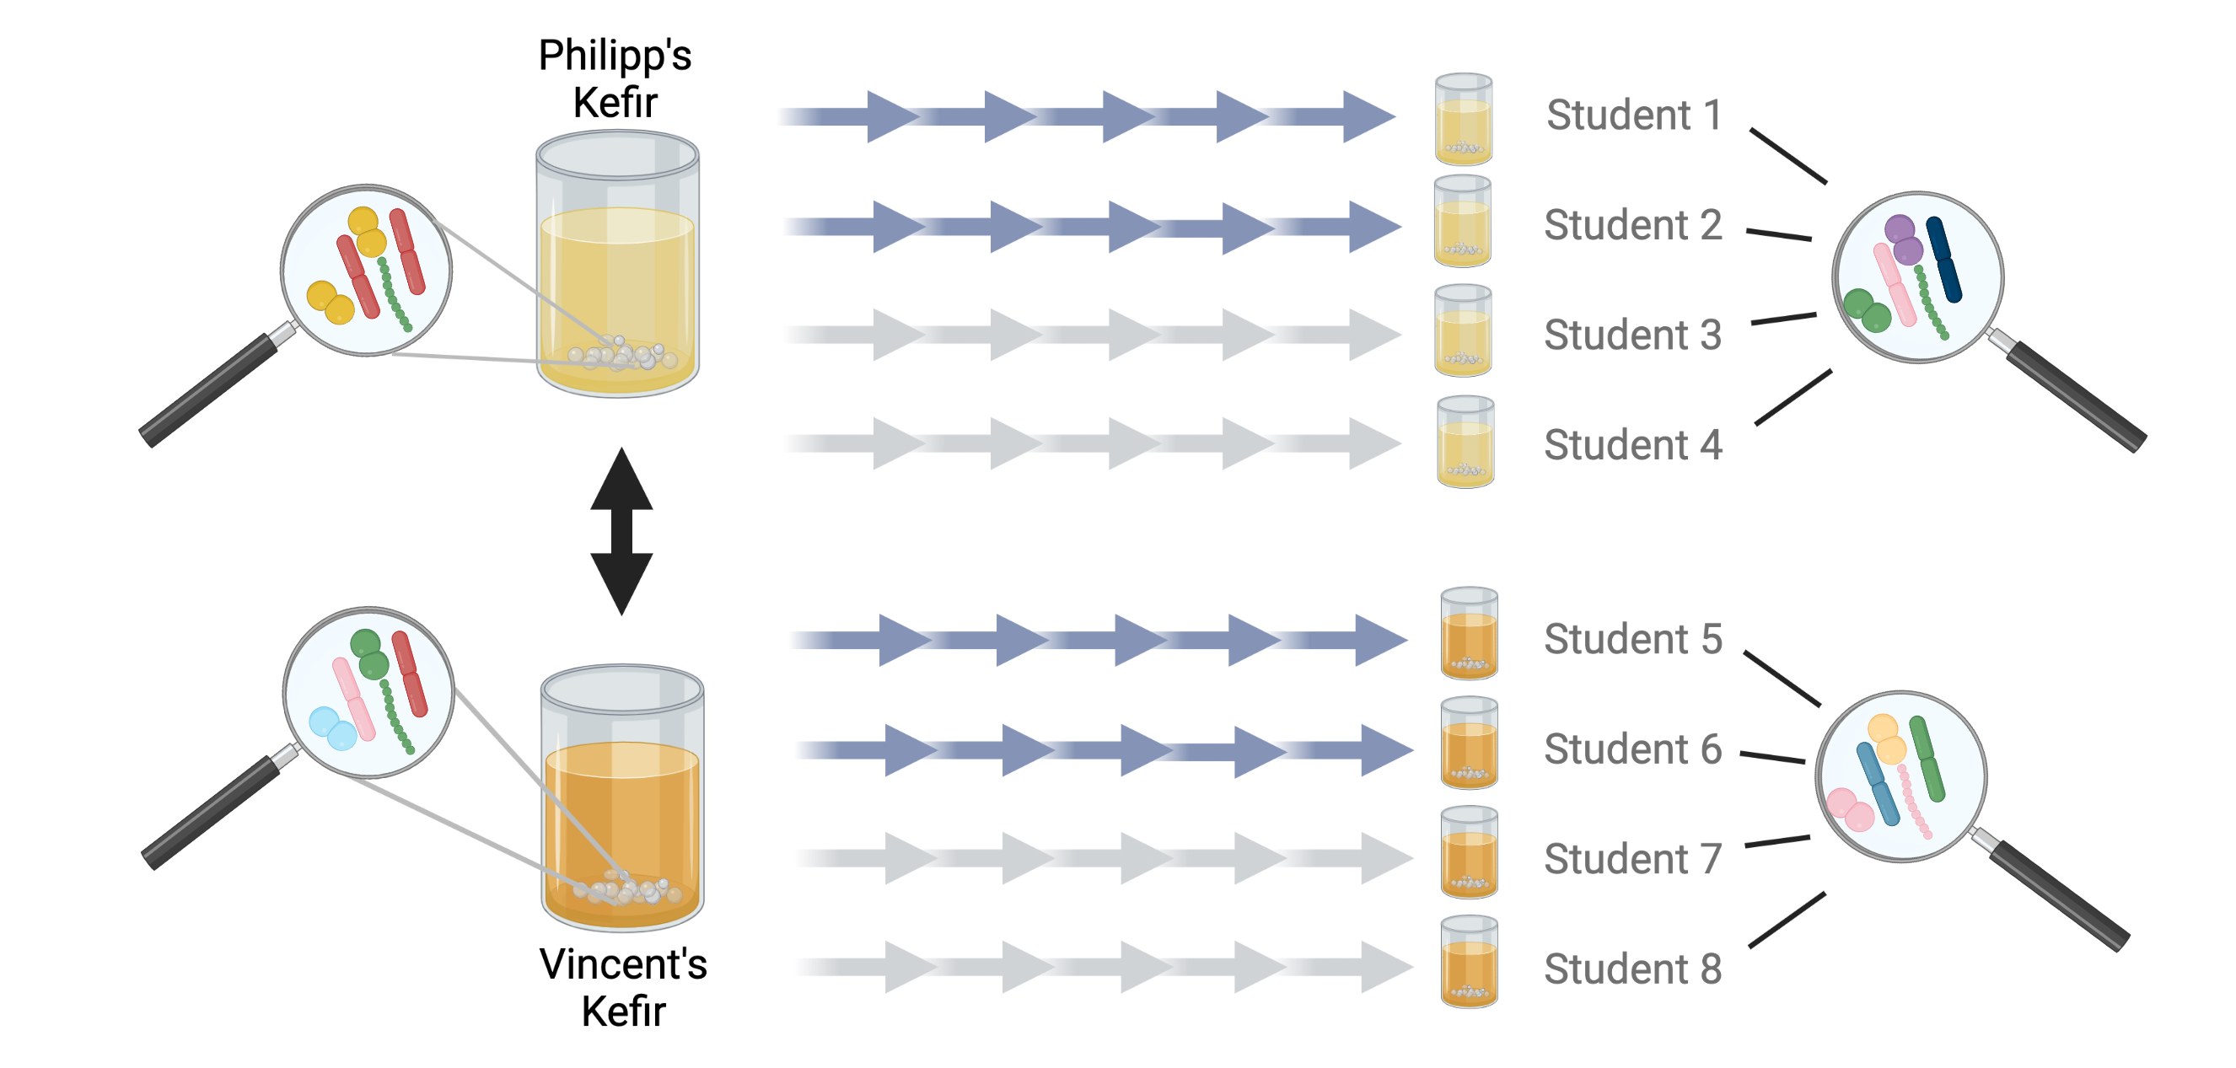
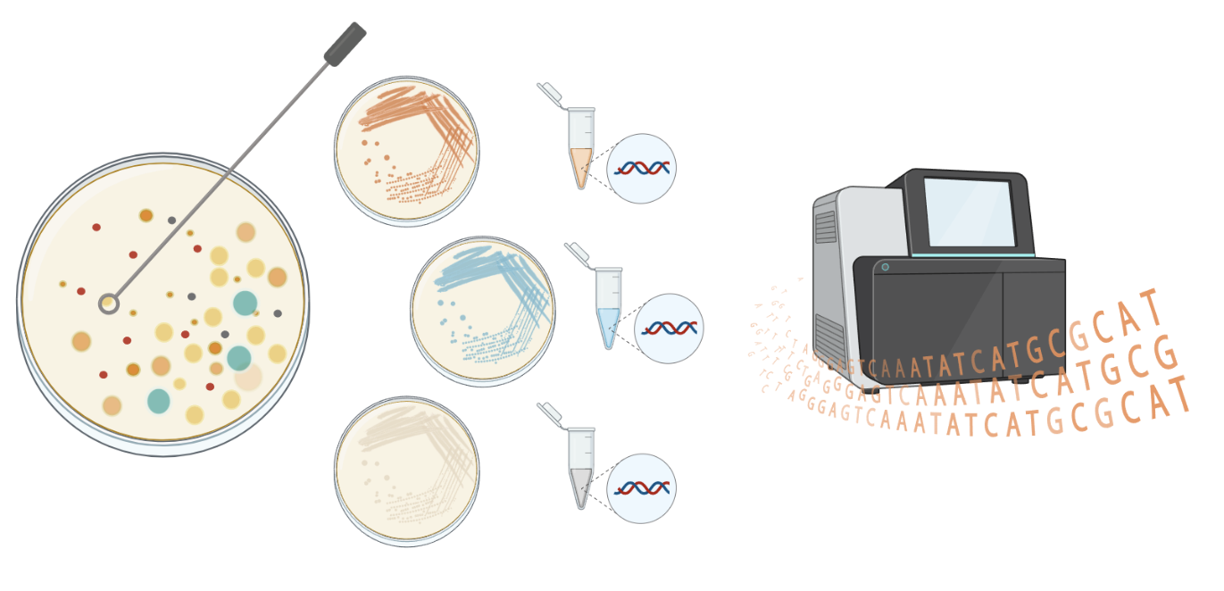
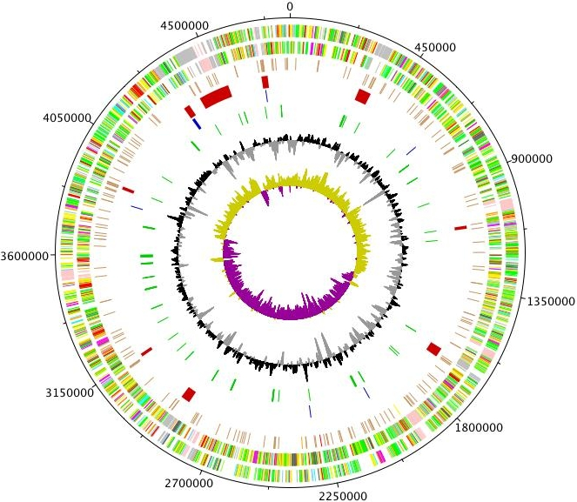
Background
Culture-dependent approach
(SAGE I)
Water kefir
Limited diversity
Environment reproducible
Often culturable
Ancient
Isolation
DNA extraction
Sequencing
Who is there?
What are they doing?
Did we isolate/culture every genotype/species present in the water kefir?
Lentilactobacillus
Liquiorilactobacillus
Lacticaseibacillus
Notes:
By now, you should all be familiarized with our research topic: Water Kefir; a fermented drink that has multiple properties that makes it interesting to study. This include a limited diversity, an environment that is highly reproducible, is an ancient drink which means is quite stable over time; over multiple cultures and the organisms that are responsible for this fermentation are often culturable. Our main goal is to know who is there? Which organisms are present in water kefir and how is their abundance and what are they doing; what role do they have in this fermentation process. One way of studying this, is what you did during SAGE I. Basically from the kefir granules phenotypically different bacteria were isolated, followed by DNA extraction, sequencing by Illumina and ONT and then you spend the last semester analyzing the genomes of this bacteria. At the end, you were able to classify this bacteria, being able to answer, at least partially to the question of “who is there”, and also you were able to take a look at their genes to infer functionality. A further analysis of these genes will be able to know the functional potential of each of these individuals in relation to the water kefir; to the fermentation process. However, the big question here is… did we isolate/culture every genotype/species present in the water kefir? Even if we really tried and picked multiple colonies that looked similar to try and capture different strains, the reality is that no, generally with culture-dependent approaches we lose a lot of the diversity present in environmental samples.

Slide 4
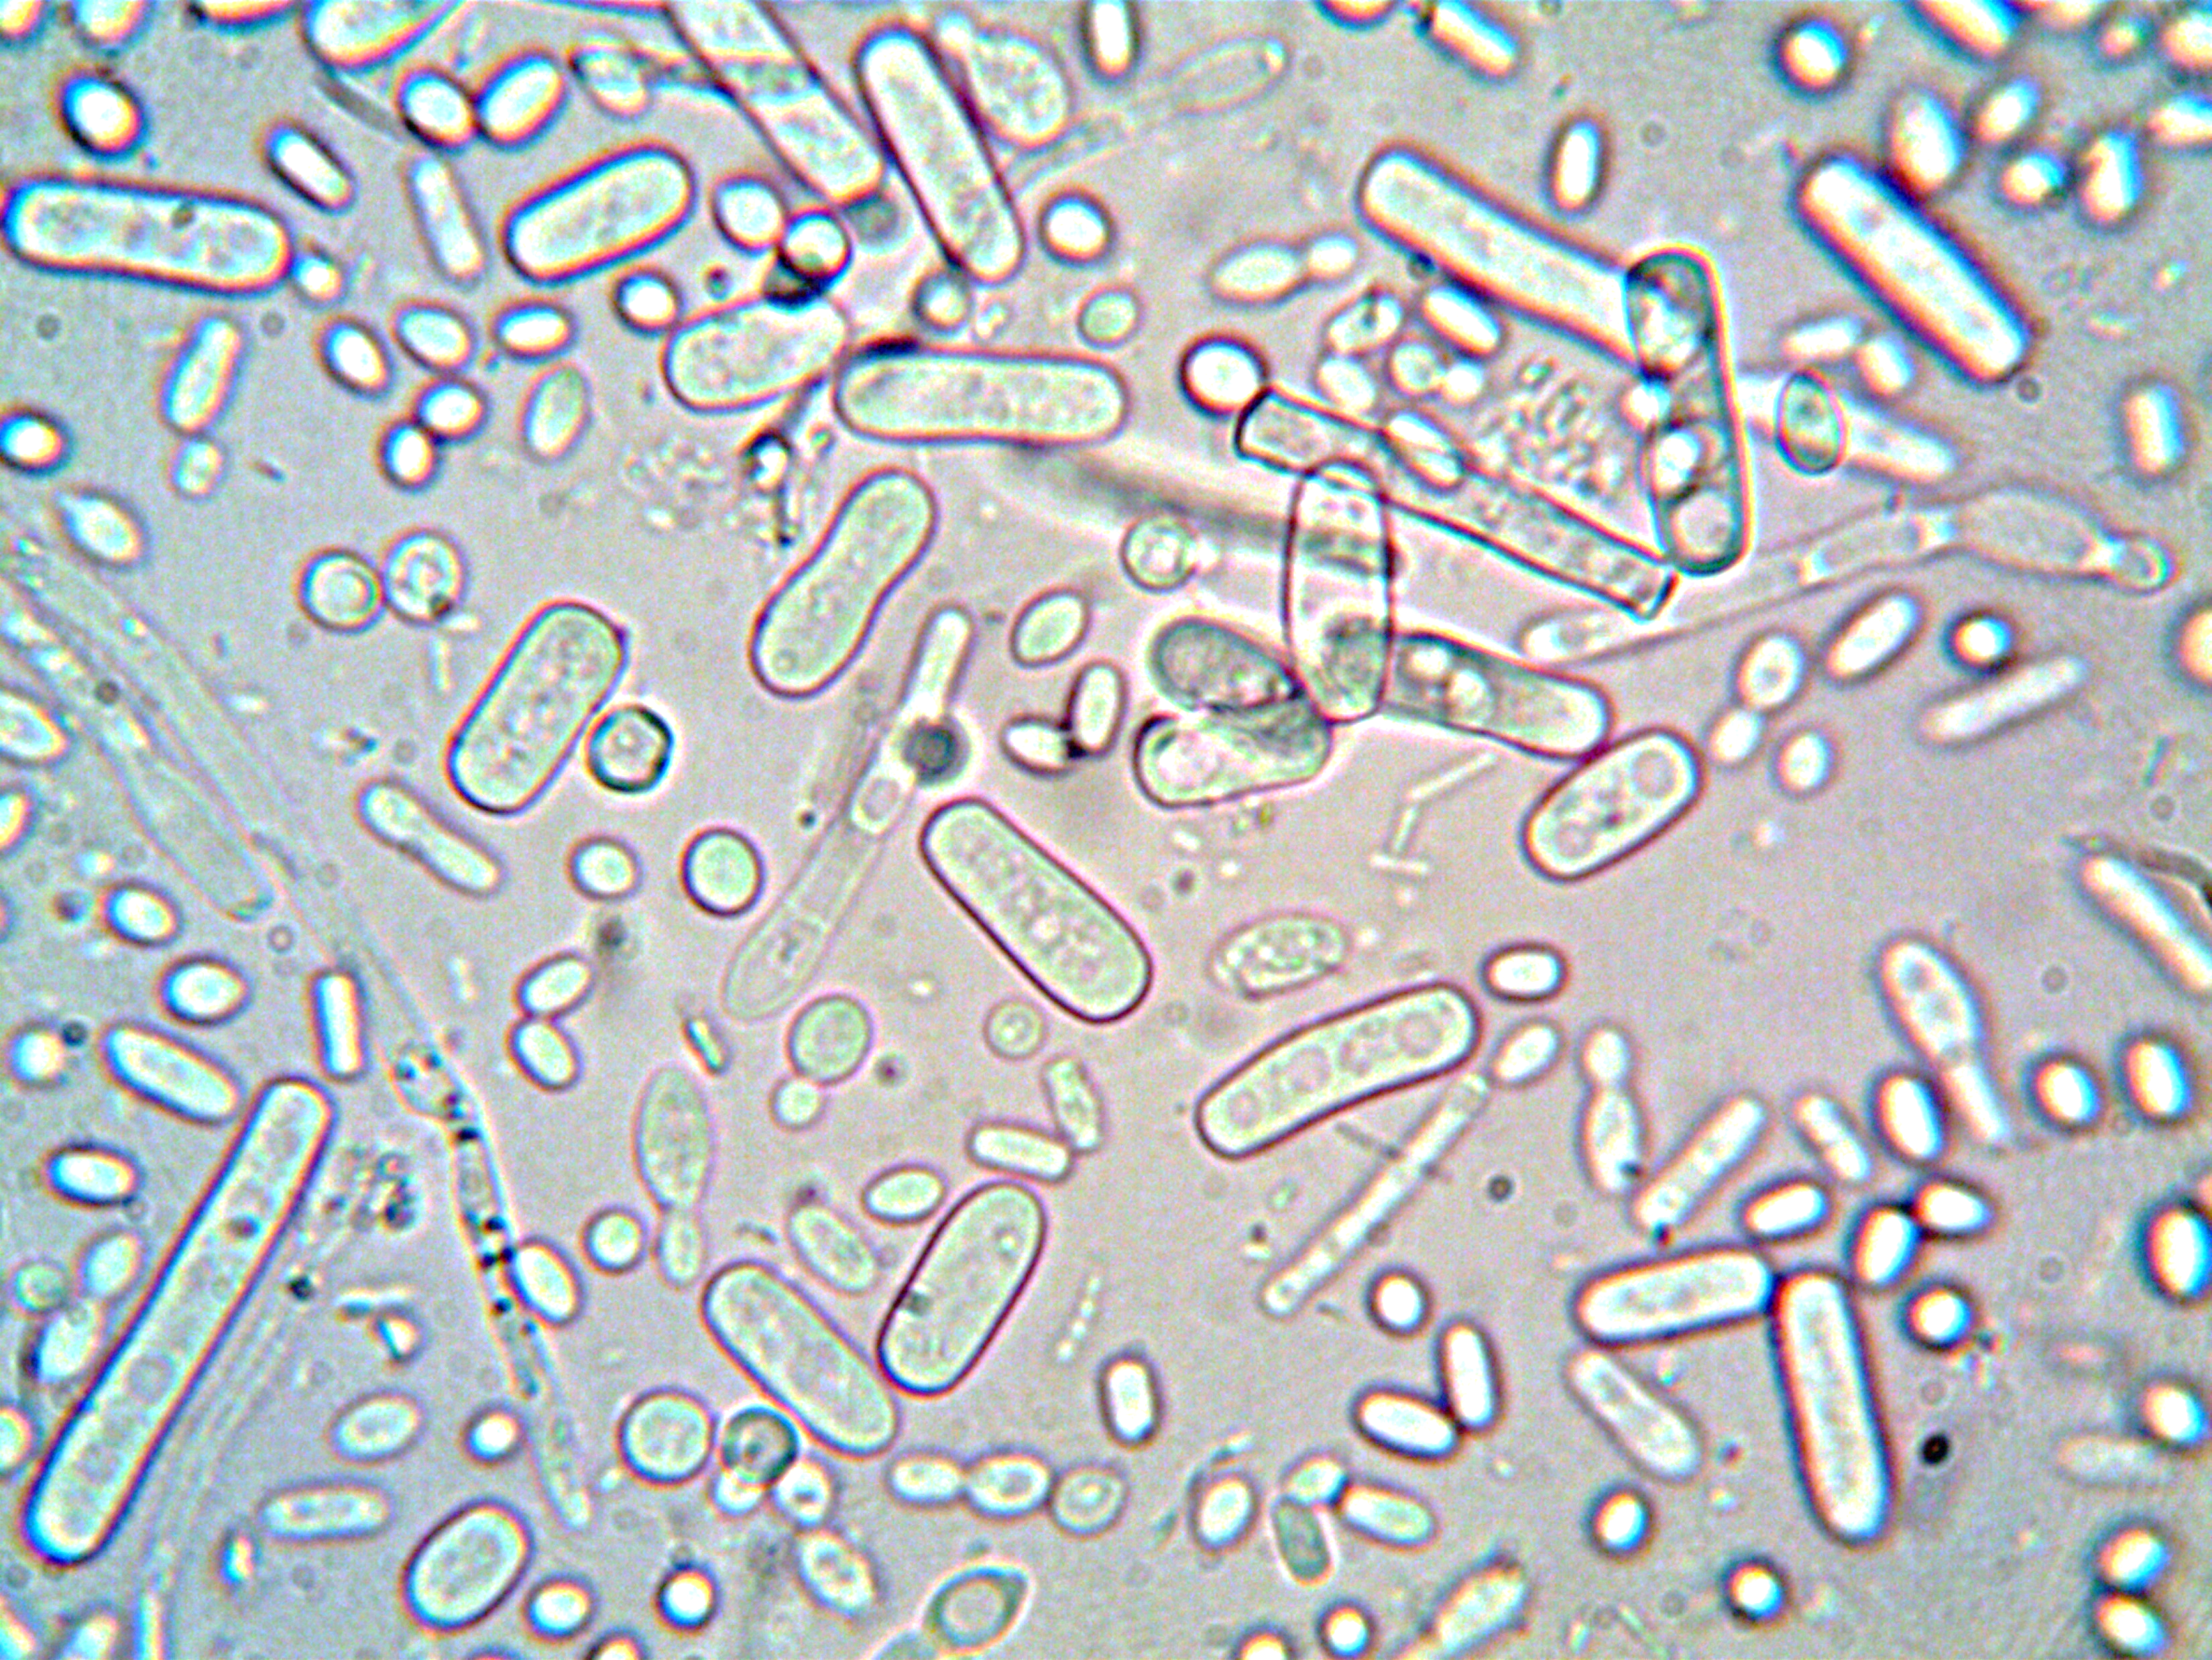
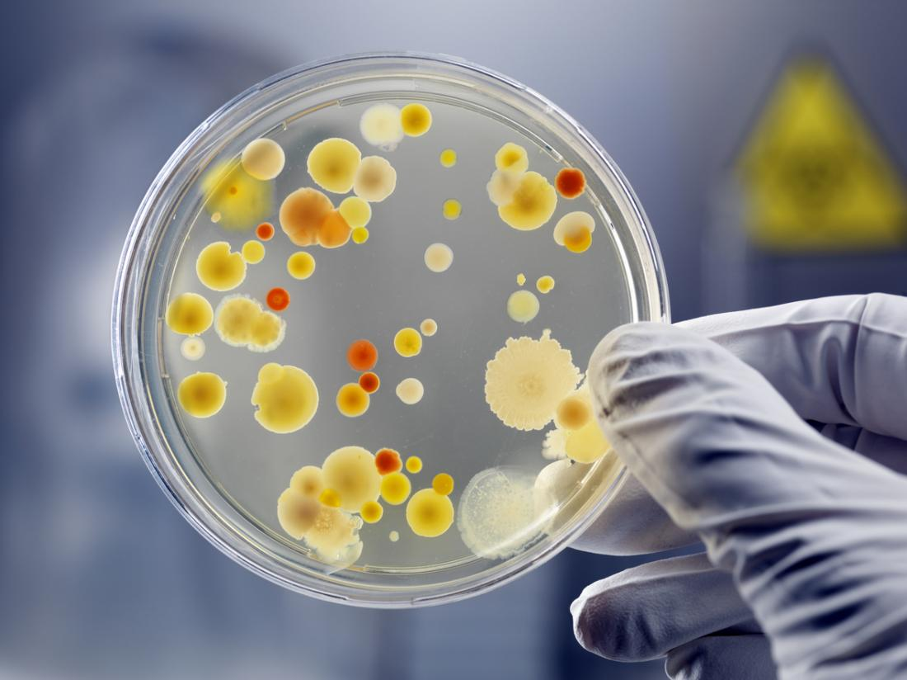
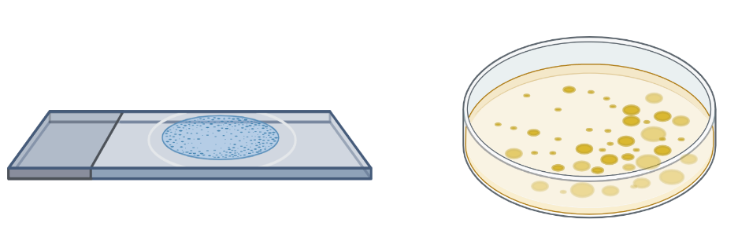
Background
The great plate count anomaly
the term we use to describe the observation that microscopic cell counts are significantly higher than corresponding counts of colony forming units (CFUs) on agar plates – unculturable bacteria
Microscopy cell counts
>>>
CFUs
counts
Nutritional requirements
Environmental conditions
Media toxicity
Dependent on other bacteria
…
Culture-independent
Culture-dependent
Depending on the specific environment, up to 99% of all cells are uncultured – the majority is unculturable
Hofer U. The majority is uncultured. 2018. Nature Reviews Microbiology, 16(12), 716-717
Notes:
This bring us to what is often referred as the great plate count anomaly.

Slide 5
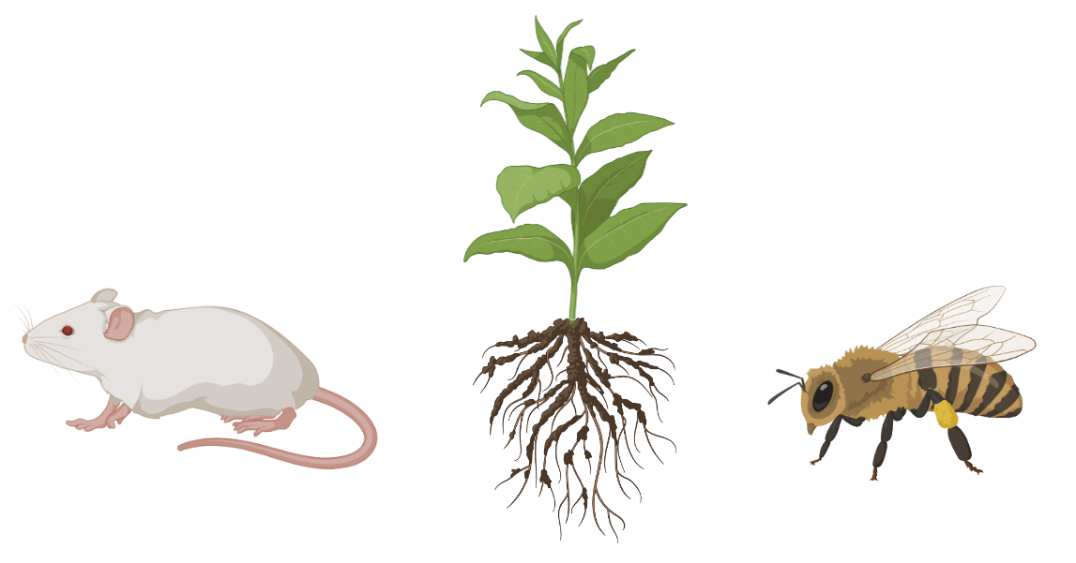
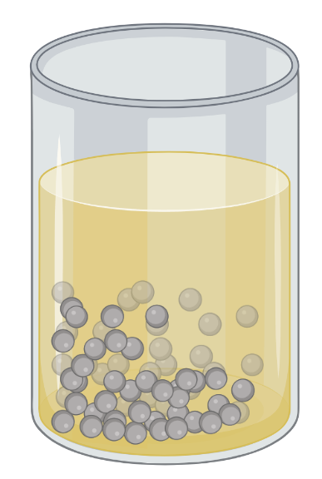
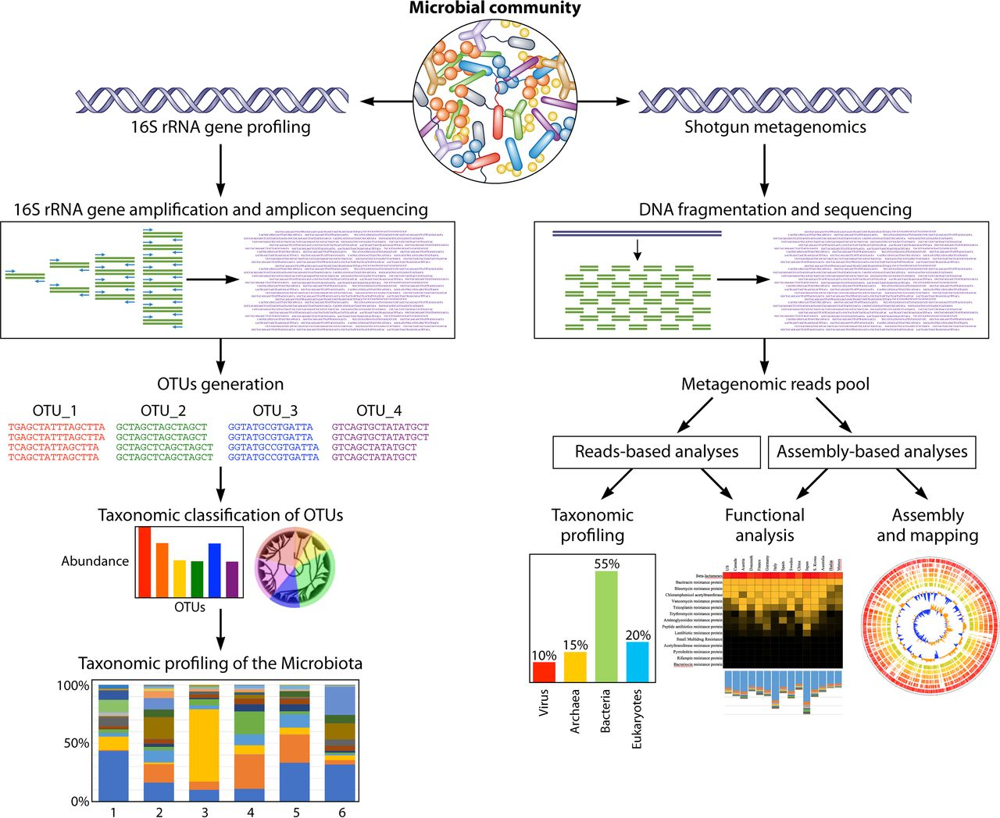
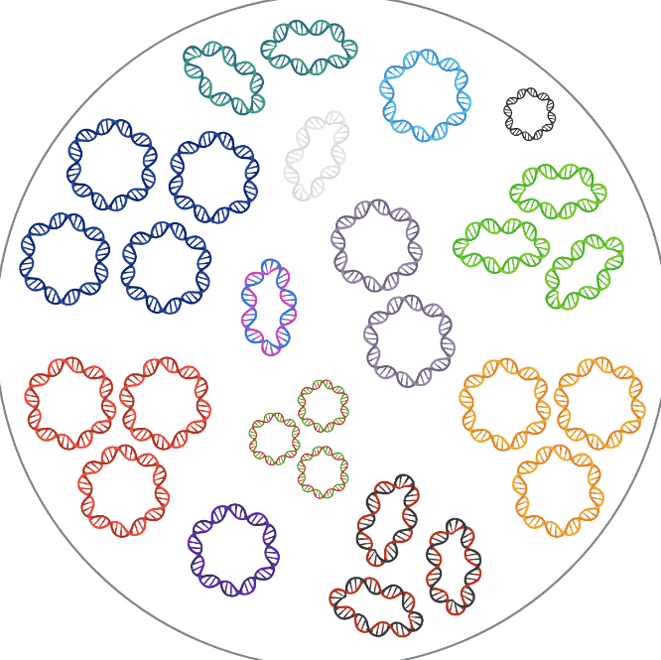
Metagenomics
How do we study unculturable bacteria?
Microbial communities
Who is there?
What are they doing?
Total community DNA extraction
Metagenome
collection of genetic material (genomes) extracted directly from an environmental/clinal sample
Metagenomics is the study of metagenomes by sequencing
Notes:
This bring us to what is often referred as the great plate count anomaly.

Slide 6
Metagenomics
Two types of metagenomics
Metagenome
Targeted metagenomics
16S rRNA amplicon sequencing
Shotgun metagenomics
Covered later
in SAGE II
Milani et al. Microbiol. Mol. Biol. Rev. 2017; doi:10.1128/MMBR.00036-17

Slide 7
Metagenomics
Two types of metagenomics
Metagenome
Targeted metagenomics
16S rRNA amplicon sequencing
Shotgun metagenomics
Factors | 16S rRNA sequencing | Shotgun Metagenomic Sequencing
Cost | ~$50 USD | Starting at ~$150 but price will depend on seq. depth
Functional profiling (microbial genes) | No (but ‘predicted’ functional profiling is possible) | Yes (but only ‘functional potential’)
Taxonomic resolution | Bacterial genus (sometimes species); dependent on region(s) targeted | Bacterial species (sometimes strains and single nucleotide variants, if sequencing is deep enough)
Taxonomic coverage | Bacteria and archaea (others if different primers) | All taxa, including viruses
Bioinformatics requirements | Beginner to intermediate expertise | Intermediate to advanced expertise; computationally demanding; not defined pipelines.
Databases | Established, well-curated | Relatively new, still growing
Sensitivity to host DNA contamination | Low (but PCR success depends on the absence of inhibitors and the presence of a detectable microbiome) | High , varies with sample type (but this can be mitigated by calibrating the sequencing depth)
Bias | Medium to high (retrieved taxonomic composition is dependent on selected primers and targeted variable region) | Lower (while metagenomics is “untargeted”, experimental and analytical biases can be introduced at various stages)

Slide 8
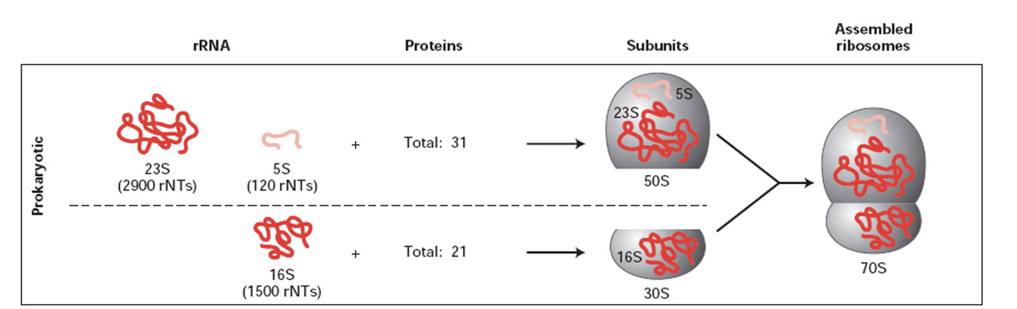
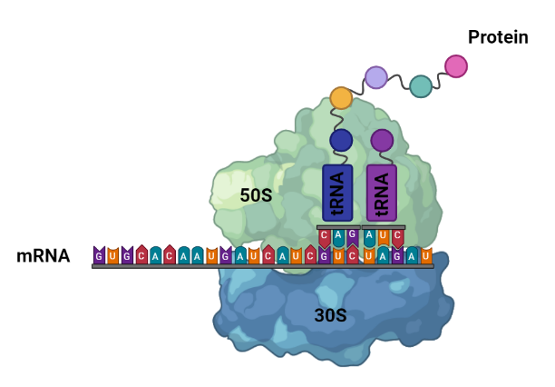
16S rRNA amplicon sequencing
Why the 16S rRNA gene?
Structural RNA component of the 30S ribosomal subunit

Slide 9
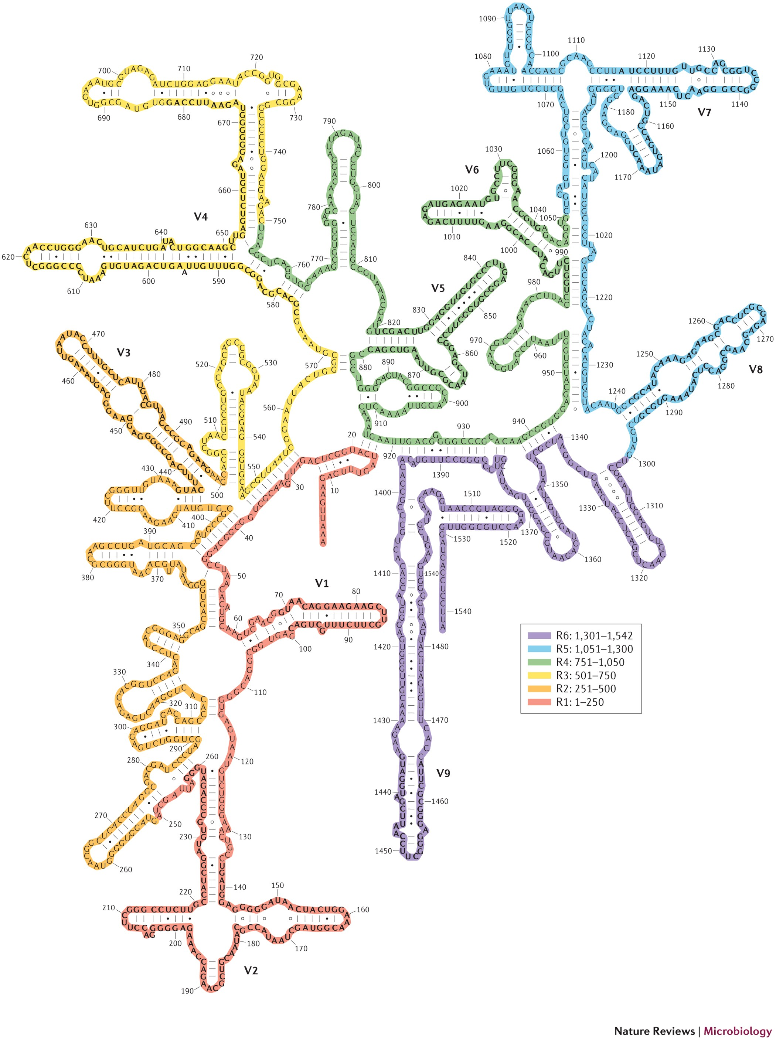
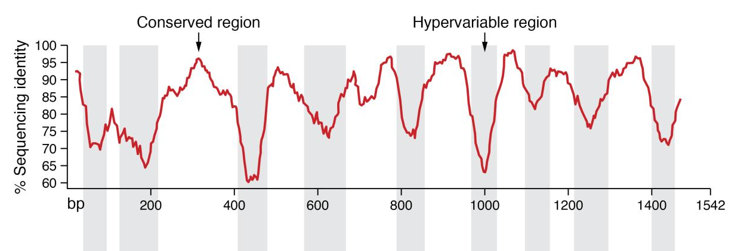
16S rRNA amplicon sequencing
Secondary structure of the 16S
Why the 16S rRNA gene?
Structural RNA component of the 30S ribosomal subunit
Universally conserved gene – all bacteria have the 16S rRNA gene
Overall low mutation rate allows comparison of lineages that diverged long ago...
… but with “faster” evolving regions that allow inspection of more recent differences!
Not subjected to horizontal gene transfer
Statistically sufficient number of nucleotides (~1500)
V7
V6
V4
V5
V3
V8
V1
V1 V2 V3 V4 V5 V6 V7 V8 V9
V9
Prokaryotic ribosome
Any gene that fulfill these characteristics could be used for targeted metagenomics!
V2
Yarza et al. 2014. Nature Reviews Microbiology, 12(9), 635-645.

Slide 10
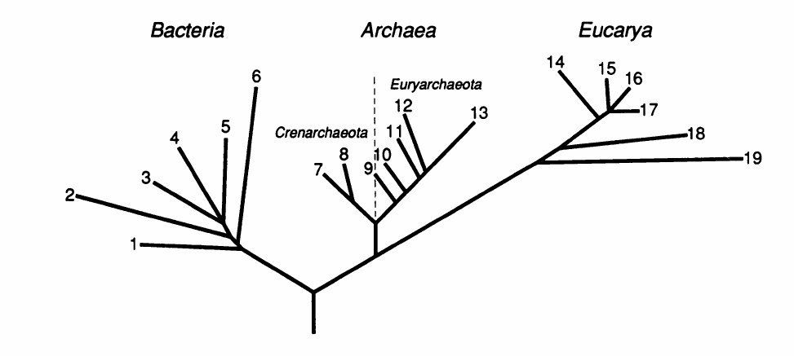
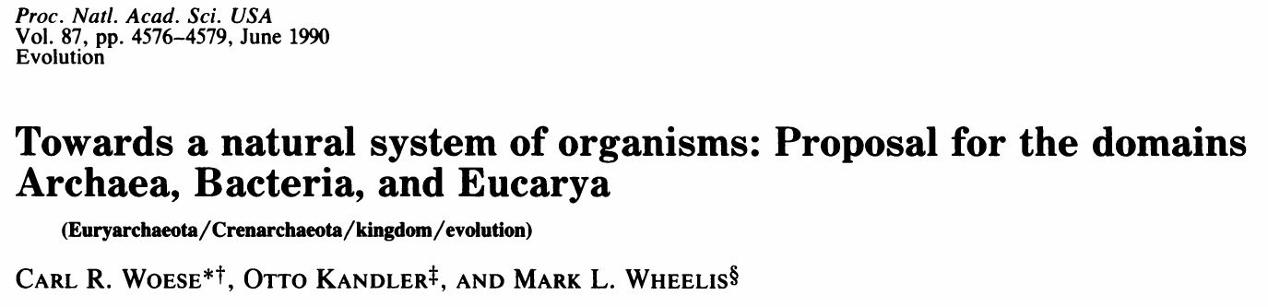
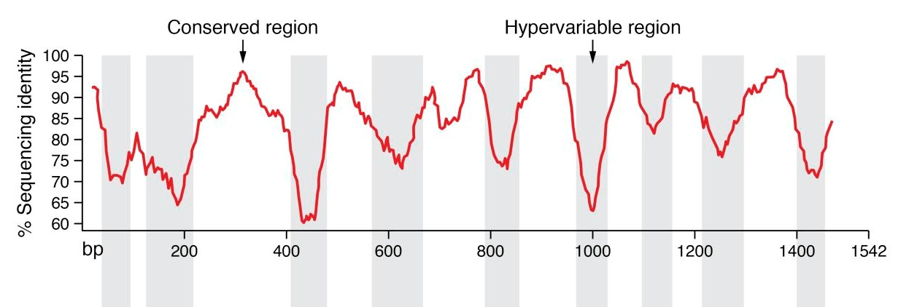
16S rRNA amplicon sequencing
Why the 16S rRNA gene?
Structural RNA component of the 30S ribosomal subunit
Universally conserved gene – all bacteria have the 16S rRNA gene
Overall low mutation rate allows comparison of lineages that diverged long ago...
… but with “faster” evolving regions that allow inspection of more recent differences!
Not subjected to horizontal gene transfer
Statistically sufficient number of nucleotides (~1500)
16S/18S rRNA-based tree
16S rRNA sequence similarity reflects evolutionary distance and serves to classify bacteria
V1 V2 V3 V4 V5 V6 V7 V8 V9

Slide 11
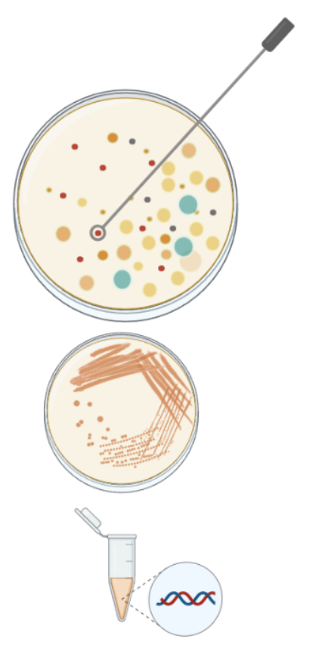
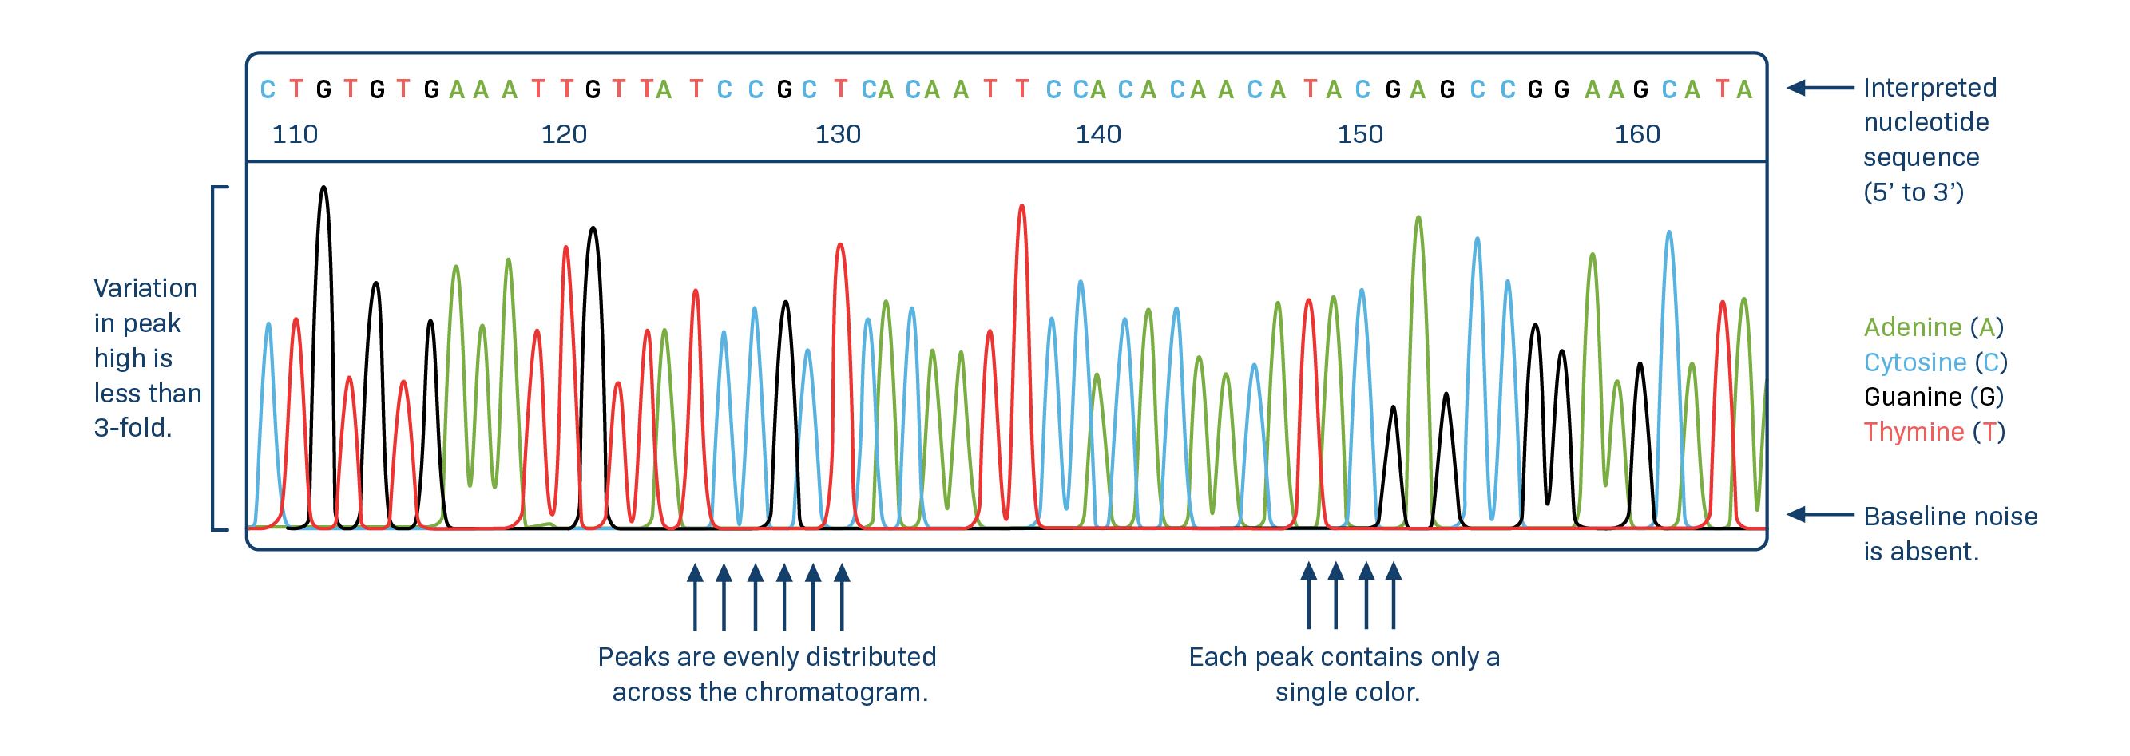
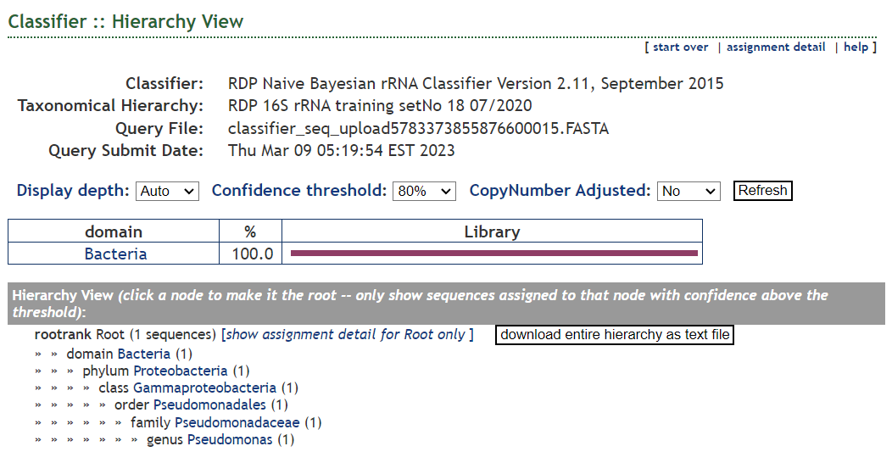

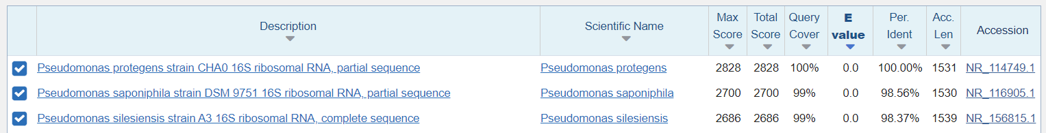
16S rRNA amplicon sequencing
Isolate vs. environmental
16S rRNA amplicon sequencing
V1 V2 V3 V4 V5 V6 V7 V8 V9
Universal consensus primers
27F
1492R
PCR amplification
Amplicon sequencing
by Sanger sequencing
DNA sequence
Isolate DNA
Classification

Slide 12
16S rRNA amplicon sequencing
Isolate vs. environmental
16S rRNA amplicon sequencing
V1 V2 V3 V4 V5 V6 V7 V8 V9
Universal consensus primers
27F
1492R
PCR amplification
Amplicons with different sequences
Amplicon sequencing
by Sanger sequencing
DNA sequence
Undetermined sequence
N N N N N N N N N N N N N N N N N N N N N N N N N N N N N N N N N N N N N N N N N N N N N N N N N N N N N N N N N N N
Overlapping signal
Isolate DNA
Environmental DNA
Sequencing of environmental amplicons not possible with Sanger sequencing due to mixed sequences

Slide 13
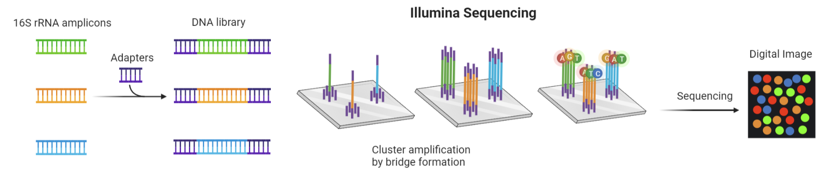
16S rRNA amplicon sequencing
High-throughput sequencing
Illumina sequencing
During cluster amplification, individual DNA molecules are amplified and sequenced in parallel
Read size limitation of 250 - 300 nt
V1 V2 V3 V4 V5 V6 V7 V8 V9
Universal consensus primers
27F
1492R
PCR amplification
Amplicons with different sequences
Every DNA molecule is sequenced independently
Every cluster contains copies of the same individual DNA molecule

Slide 14

16S rRNA amplicon sequencing
High-throughput sequencing
Illumina sequencing
During cluster amplification, individual DNA molecules are amplified and sequenced in parallel
Read size limitation of 250 nt
reads need to overlap! – insert size <500 bp
V1 V2 V3 V4 V5 V6 V7 V8 V9
515F
806R
V4, insert size of 300 bp
341F
806R
V3-V4, insert size of 470 bp
Select primers for a specific region
515F
907R
V4-V5, insert size of 450 bp
799F
1193R
V5-V6, insert size of 435 bp
Every DNA molecule is sequenced independently
Every cluster contains copies of the same individual DNA molecule

Slide 15
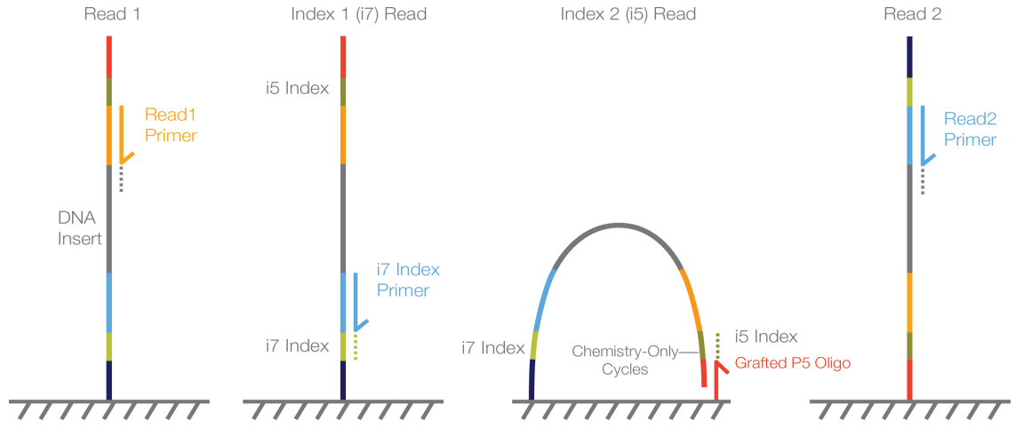
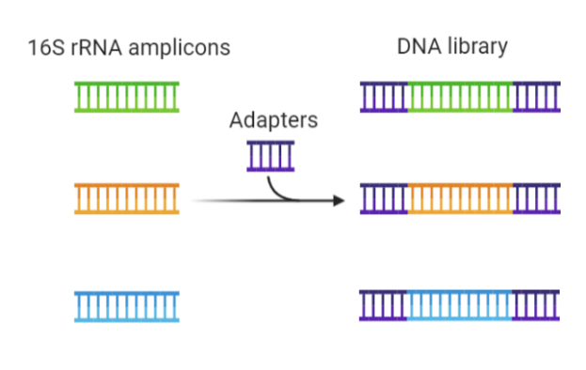
16S rRNA amplicon sequencing
1
2
3
4
High-throughput sequencing
Strand completely extended to produce the reverse strand
Illumina sequencing
During cluster amplification, individual DNA molecules are amplified and sequenced in parallel
Read size limitation of 250 nt
reads need to overlap! – insert size <500 bp
Adapters
Grafted P5 Oligo
Flow cell
Read1 primer is hybridized and Read1 is sequenced
Index i7 primer is hybridized and sequenced
Index i5 primer is grafted (P5). Index i5 is sequenced
Read2 primer is hybridized and Read2 is sequenced
Flow cell binding regions: for hybridization to the flow cell
Index: biological sample identifier, allows multiplexing
Binding site: for sequencing the forward and reverse reads
Random Ns: to improve sequencing and clustering
4
UserPrimer: primers used for gene amplification
Sequenced for 250 cycles
5’-
P7
i7
1P
F
16S rRNA amplicon
R
2P
i5
P5
-3’
2
1
3
16S rRNA amplicon
Sequenced for 250 cycles

Slide 16
16S rRNA amplicon sequencing
High-throughput sequencing
Illumina sequencing
During cluster amplification, individual DNA molecules are amplified and sequenced in parallel
Read size limitation of 250 nt
reads need to overlap! – insert size <500 bp
Adapters
Flow cell binding regions: for hybridization to the flow cell
Index: biological sample identifier, allows multiplexing
Binding site: for sequencing the forward and reverse reads
Random Ns: to improve sequencing and clustering
UserPrimer: primers used for gene amplification
-3’
5’-
P7
i7
1P
F
16S rRNA amplicon
R
2P
i5
P5
Removed if seq. processing asked
Removed by seq. facility if reads are demultiplexed

Slide 17
Taxonomic resolution of
16S rRNA sequences

Slide 18


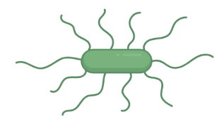
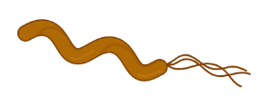
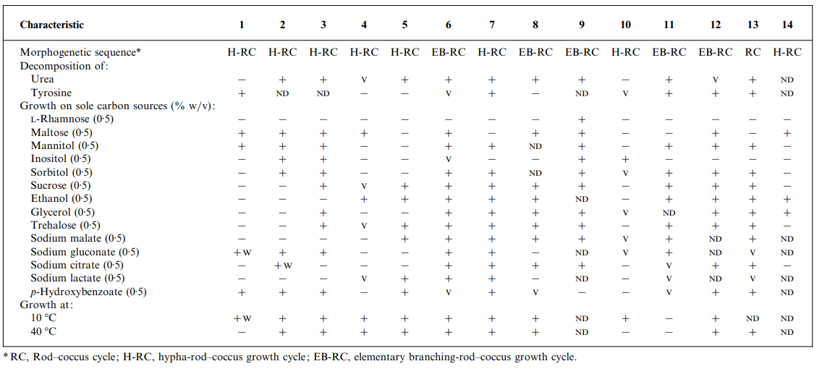
Taxonomic resolution of 16S rRNA sequences
What are prokaryotic species?
“A prokaryotic species is a group of strains that are characterized by a certain degree of phenotypic consistency, showing 70% of DNA–DNA binding and over 97% of 16S rRNA gene-sequence identity”
group of strains
phenotypic consistency
Gevers et al. Re-evaluating prokaryotic species. 2005. Nature Reviews Microbiology, 3(9), 733-739
D-Fructose utilization
D-mannitol oxidation
Anaerobic
Grow at
pH 5
strains
Individual phenotypic characteristics not present other members of the species
Bacterial strain: group of organisms that belong to the same species but share certain genetic characteristics not found in other members of the species

Slide 19
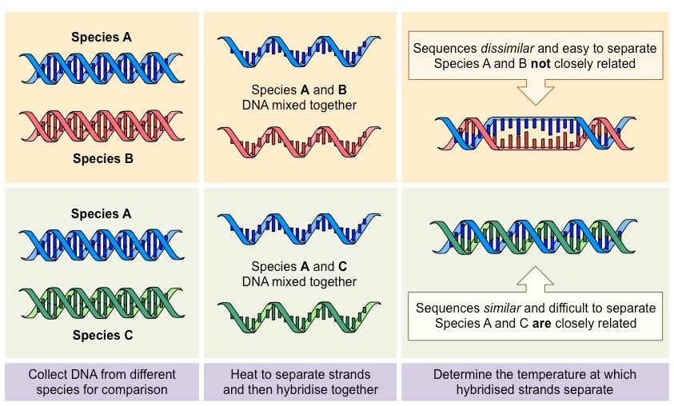
Taxonomic resolution of 16S rRNA sequences
What are prokaryotic species?
“A prokaryotic species is a group of strains that are characterized by a certain degree of phenotypic consistency, showing 70% of DNA–DNA binding and over 97% of 16S rRNA gene-sequence identity”
Gevers et al. Re-evaluating prokaryotic species. 2005. Nature Reviews Microbiology, 3(9), 733-739
Gold standard for prokaryotic species circumscription
If DNA-DNA hybridization of two strains ≥70% → same species

Slide 20
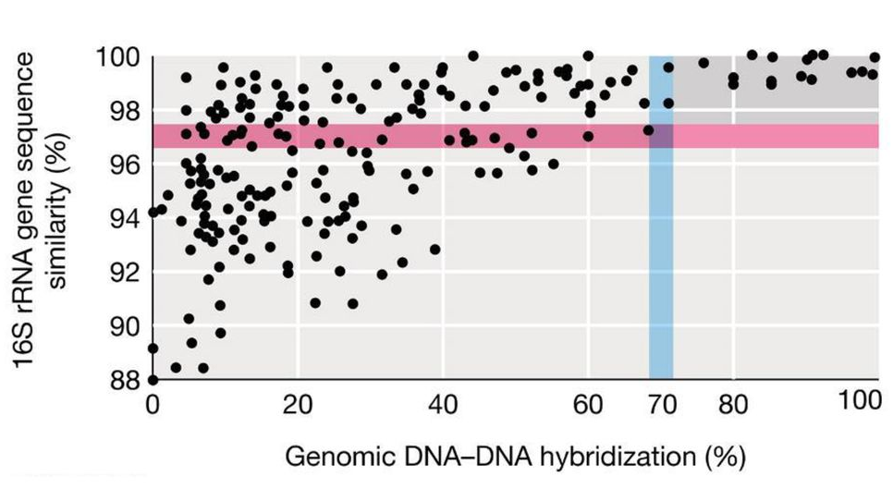
Taxonomic resolution of 16S rRNA sequences
What are prokaryotic species?
“A prokaryotic species is a group of strains that are characterized by a certain degree of phenotypic consistency, showing 70% of DNA–DNA binding and over 97% of 16S rRNA gene-sequence identity”
Gevers et al. Re-evaluating prokaryotic species. 2005. Nature Reviews Microbiology, 3(9), 733-739
Gold standard for prokaryotic species circumscription
If DNA-DNA hybridization of two strains ≥70% → same species
“One can nevertheless argue that organisms which have >70% DNA similarity will have at least 97% sequence identity.”
“...at sequence homology values below 97.5%, it is unlikely that two organisms have more than 60 to 70% DNA similarity and hence that they are related at species level.”
“...below a threshold value of 98.5% sequence similarity, the corresponding DNA reassociation values were always lower than 70%.”
“... reassociation experiments need only be performed for strains that shared 16S rRNA gene sequence similarities higher than 98.7-99%”.
“... rare examples may exist […] in which reassociation values >70% emerge at corresponding 16SrRNA similarities ~99%”.
The >97% of 16S rRNA gene sequence similarity golden threshold is considering the FULL LENGTH.
A 16S rRNA gene fragment does not have enough resolution at species level!
In practice, description of novel prokaryotic species must follow a polyphasic approach, being supported by both phenotypic and genetic/genomic differences

Slide 21
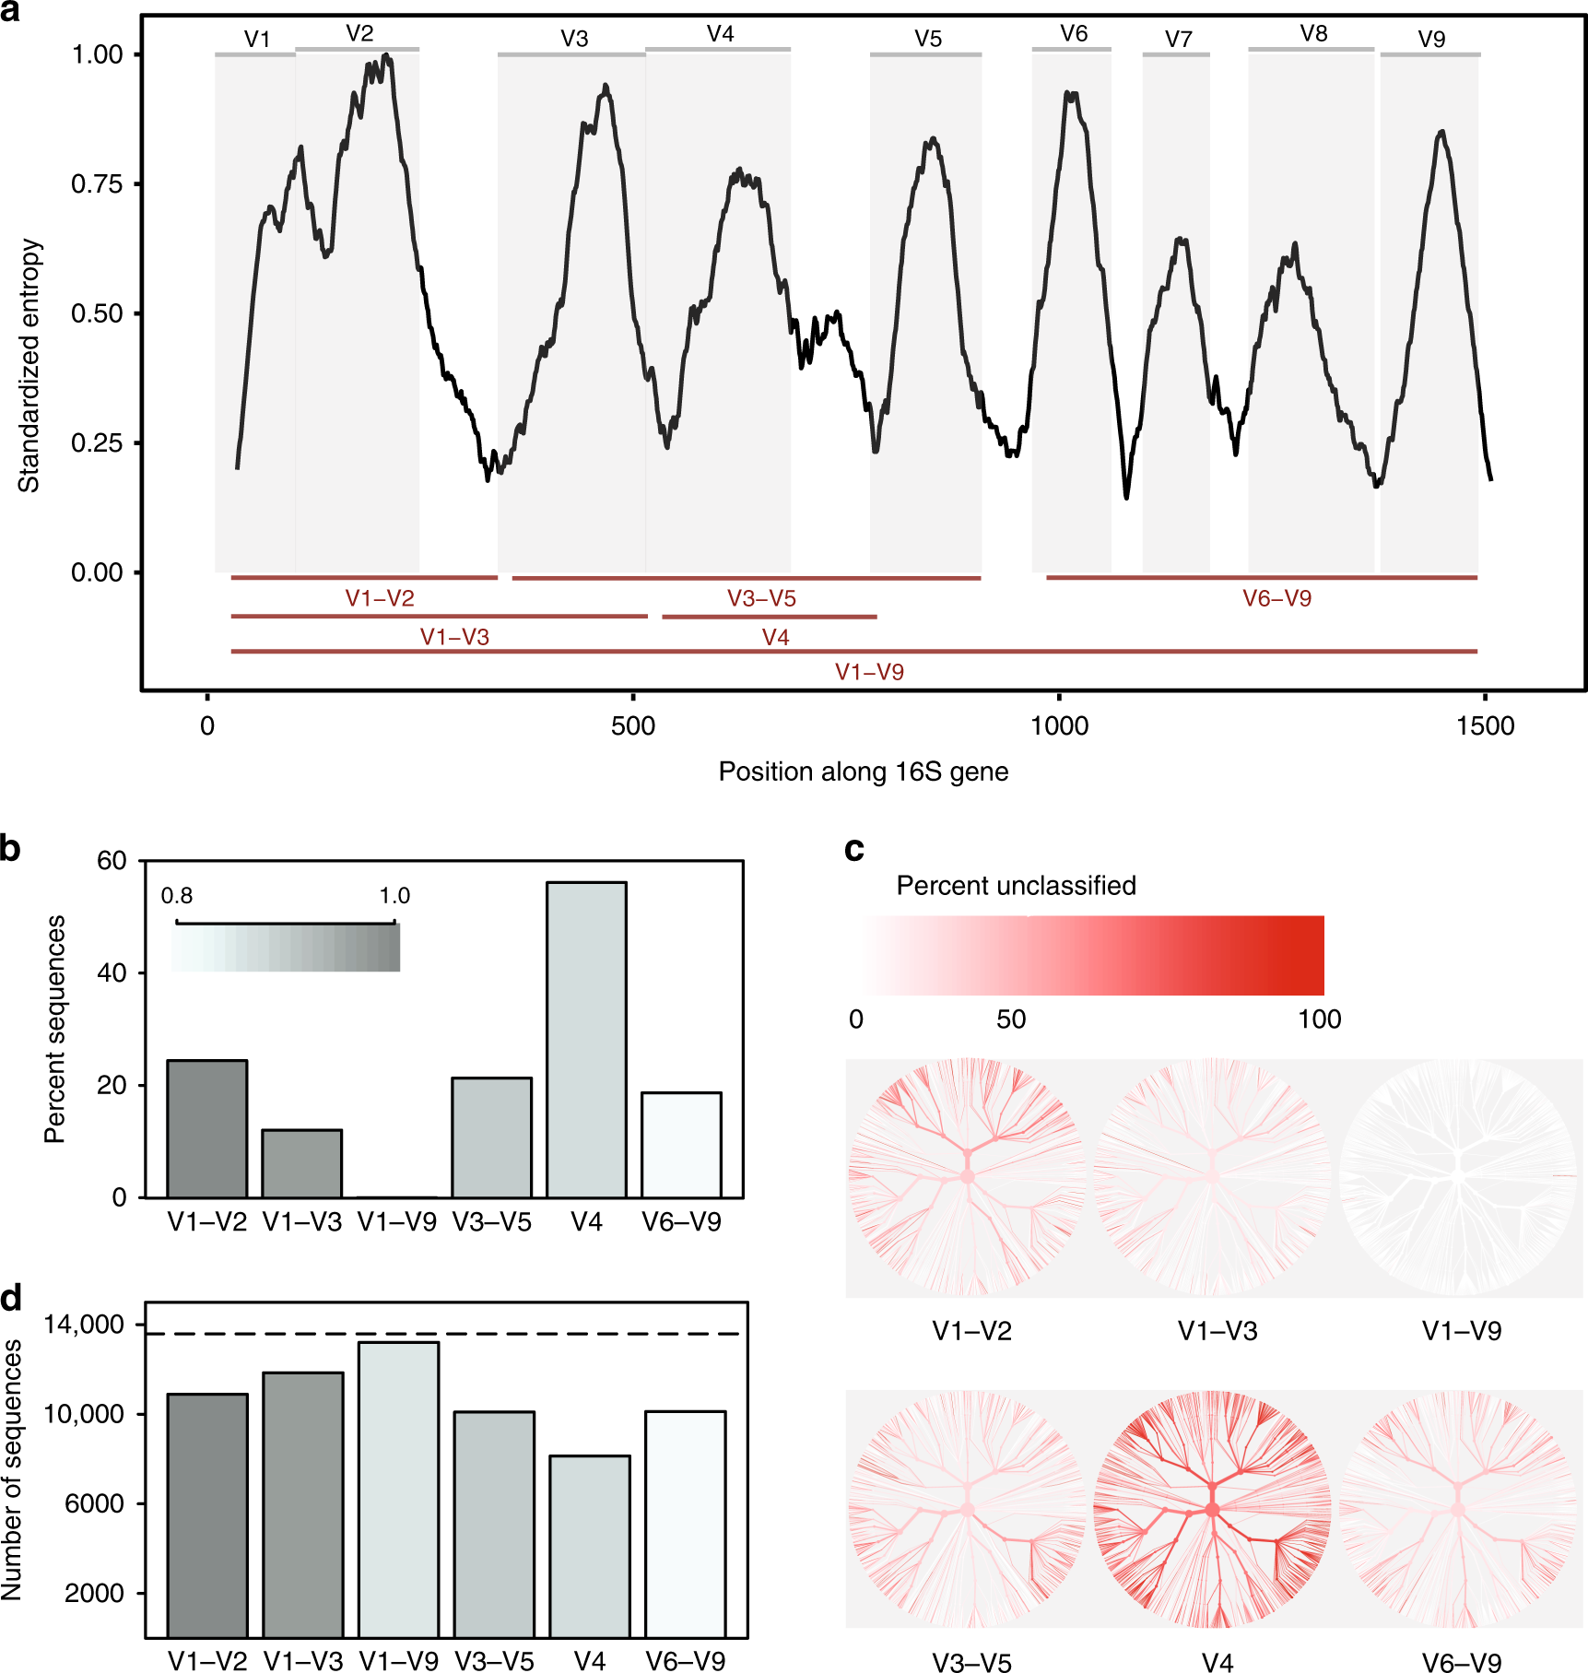
Taxonomic resolution of 16S rRNA sequences
Resolution of 16S rRNA regions
Only the full 16S rRNA gene provides enough resolution at the species level
V1 V2 V3 V4 V5 V6 V7 V8 V9
Percentage unclassified at Species level
Johnson et al. Evaluation of 16S rRNA gene sequencing for species and strain-level microbiome analysis. 2019. Nature communications, 10(1), 5029
 | Short read | Long read
Company | Illumina | PacBio | ONT | ONT
Read length range | 50 – 300 bp | >1kb | Up to 100s of kb | Up to 100s of kb
Accuracy | High (99.9%) | Low; 85% (High with CCS PacBio HiFi) | Low; 85% (Medium with most recent library prep/analysis) | Low; 85% (Medium with most recent library prep/analysis)
Typical used for | GBS/RAD sequencing Whole-genome sequencing Hi-C (genome assembly scaffolding) | Studying structural variants Genome assembly
Relative cost | Intermediate | High | Low

Slide 22
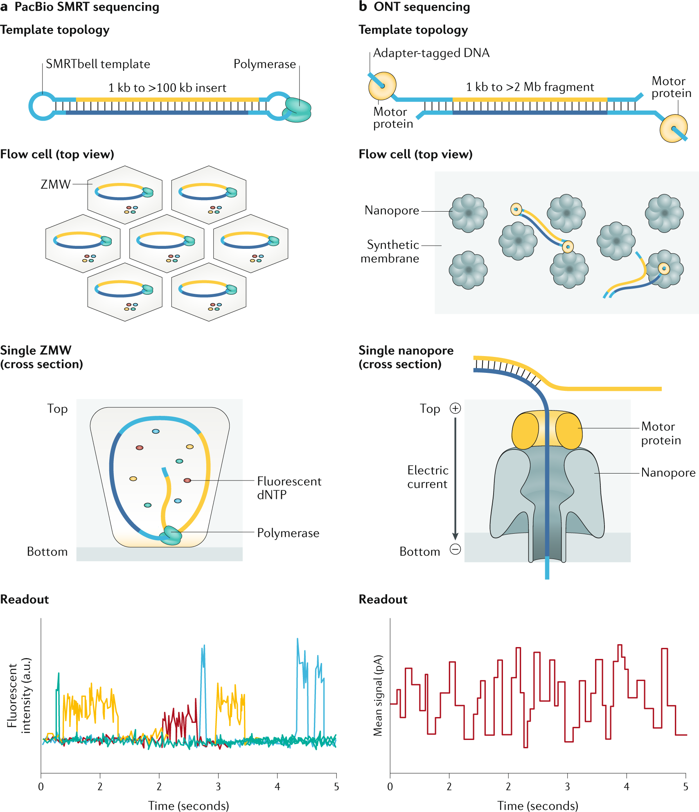
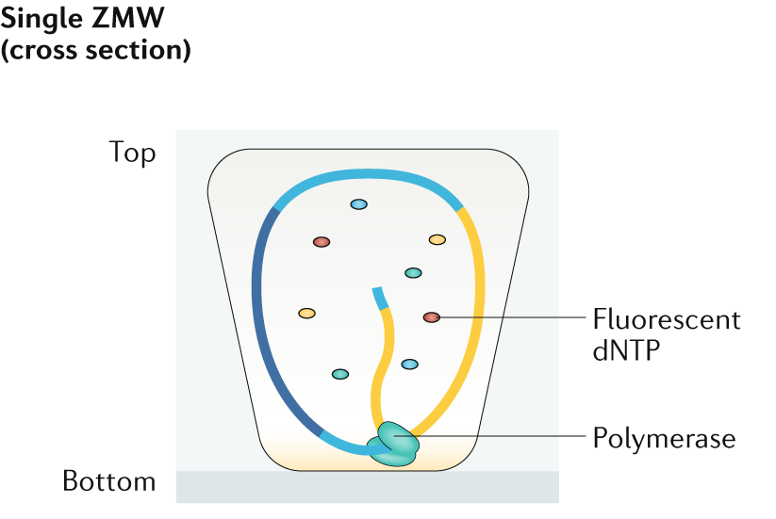
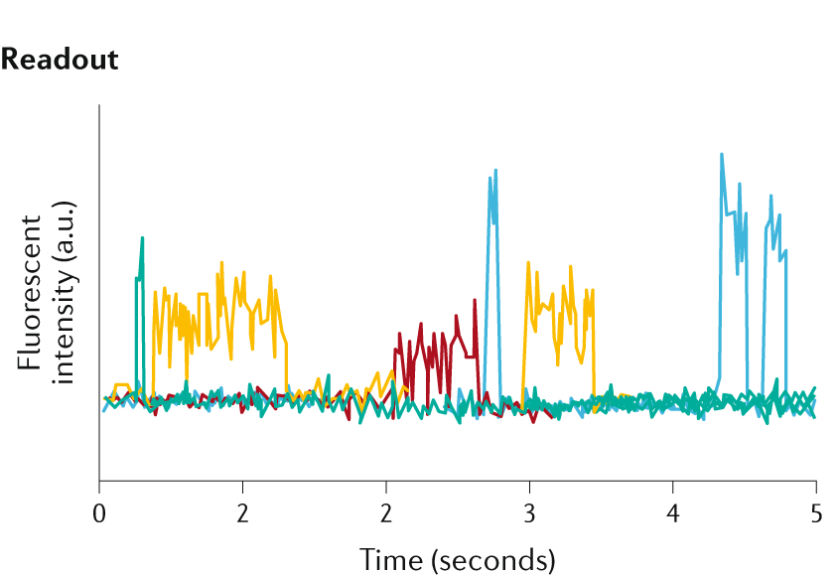
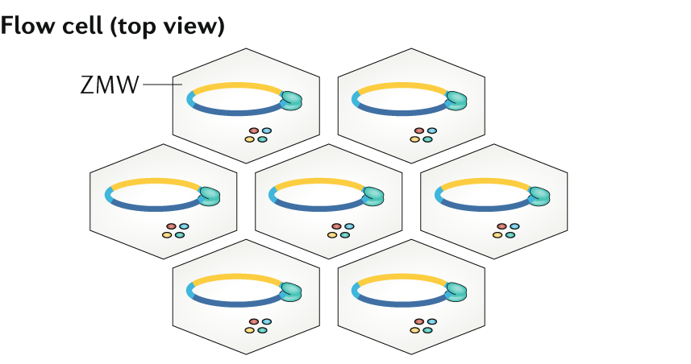
Taxonomic resolution of 16S rRNA sequences
Full-length 16S rRNA sequencing
PacBio SMRT sequencing
Single-molecule per ZMW
Error rate reduced by circular consensus sequencing (CCS). Error rates similar to Illumina
Due to the SMRTbell, the circular DNA molecule can be sequenced multiple times and a consensus low-error rate read generated.

Slide 23
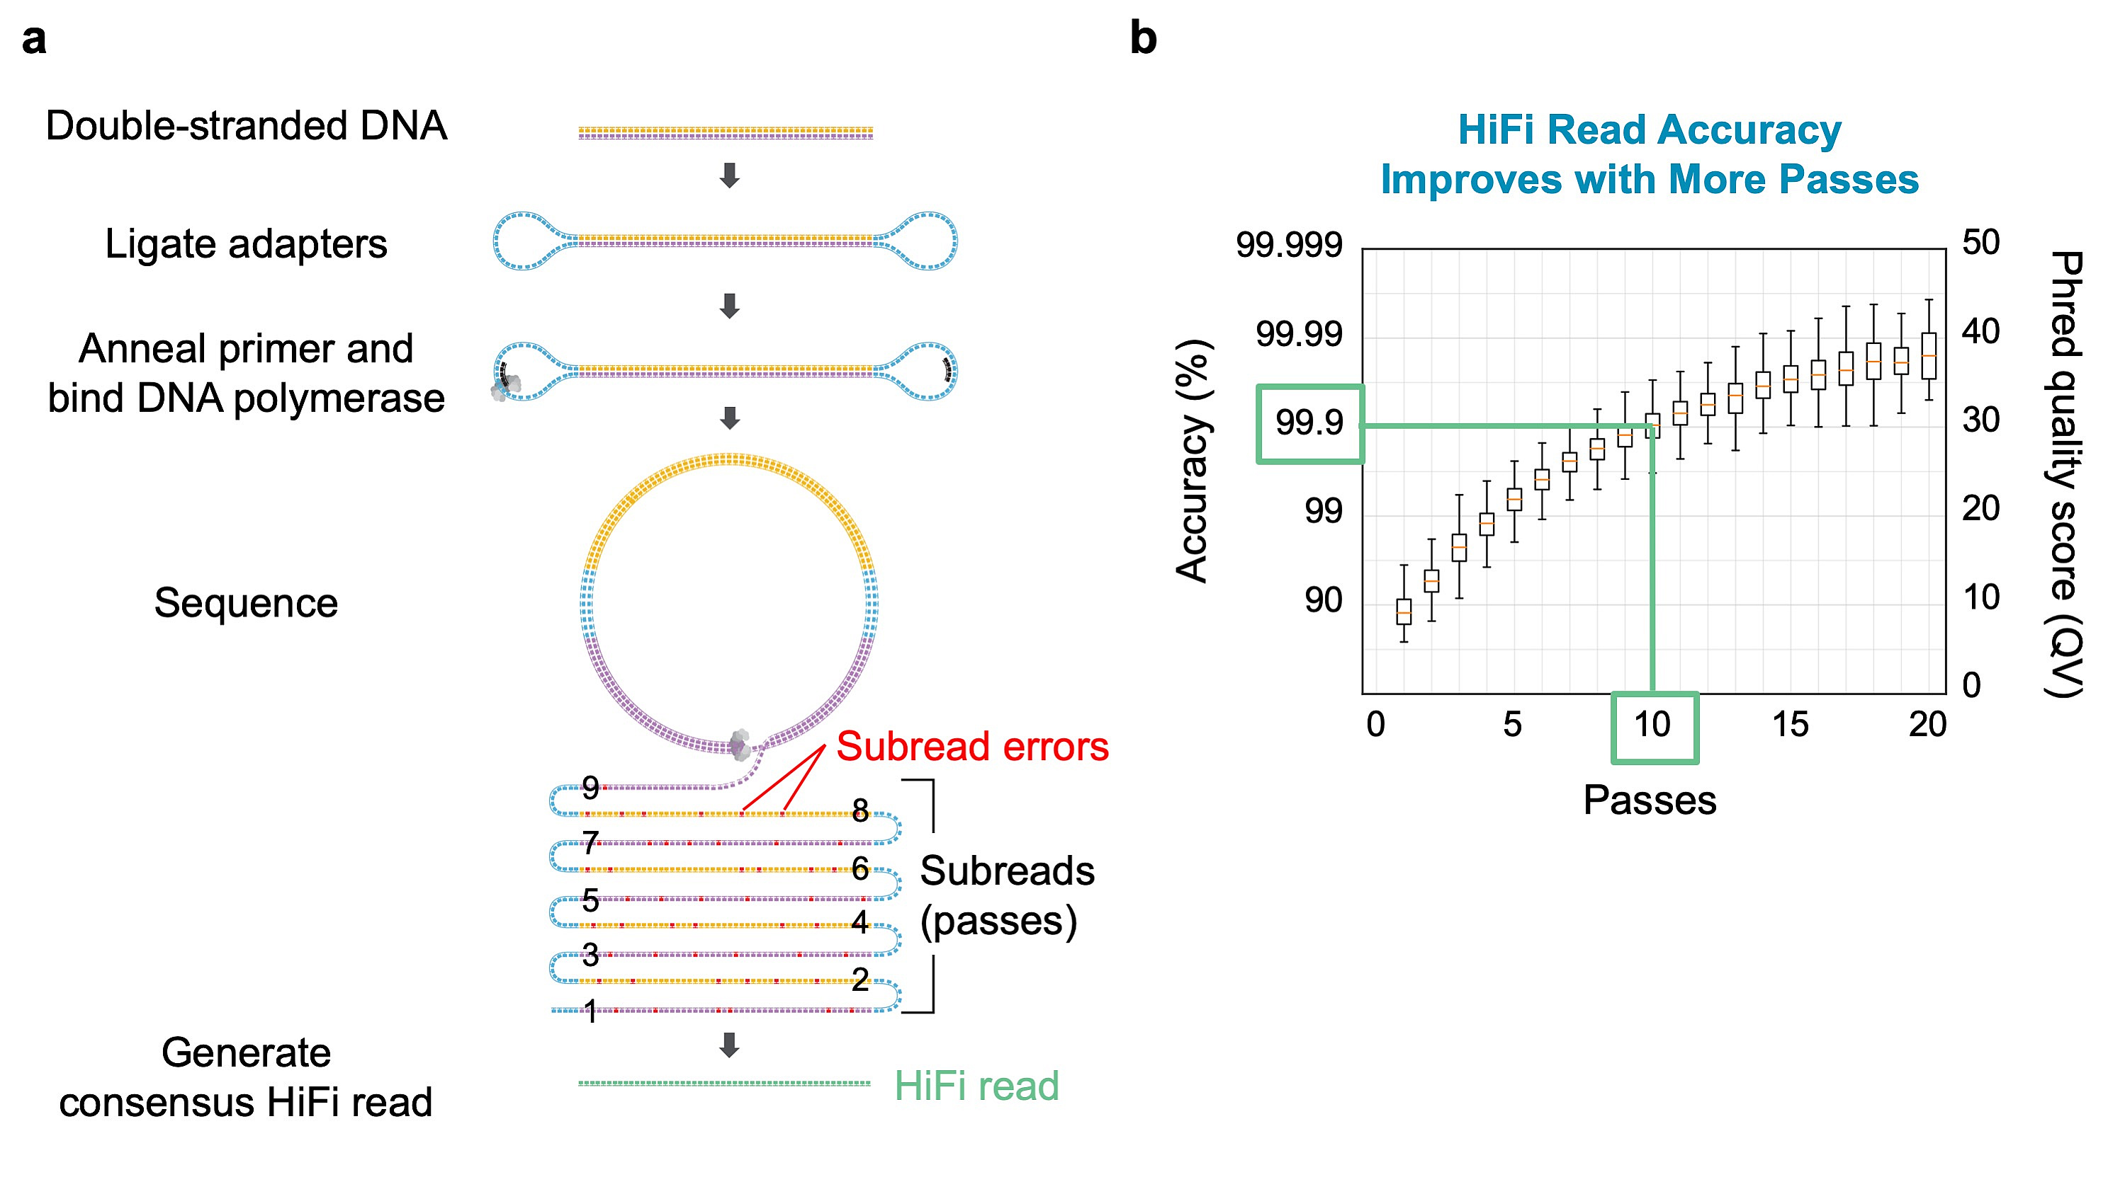
Taxonomic resolution of 16S rRNA sequences
Full-length 16S rRNA sequencing
PacBio SMRT sequencing
Single-molecule per ZMW
Error rate reduced by circular consensus sequencing (CCS). Error rates similar to Illumina
Sequence
Generate consensus HiFi read

Slide 24
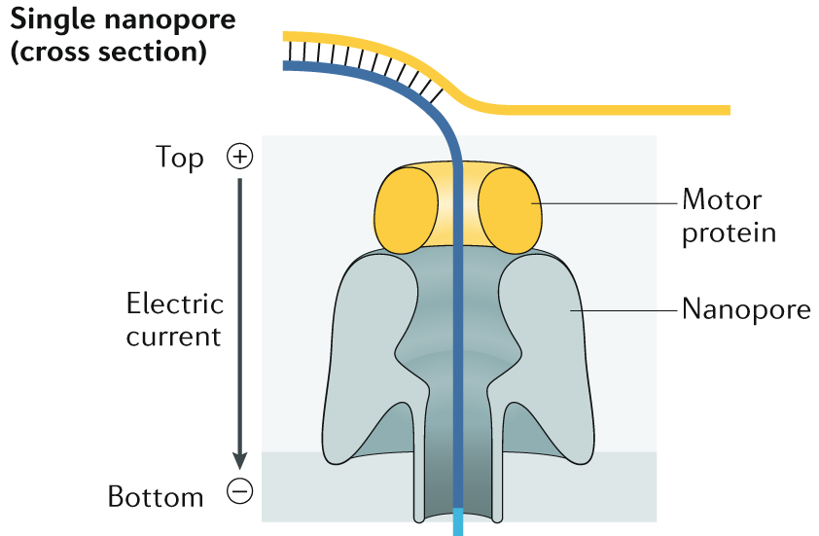
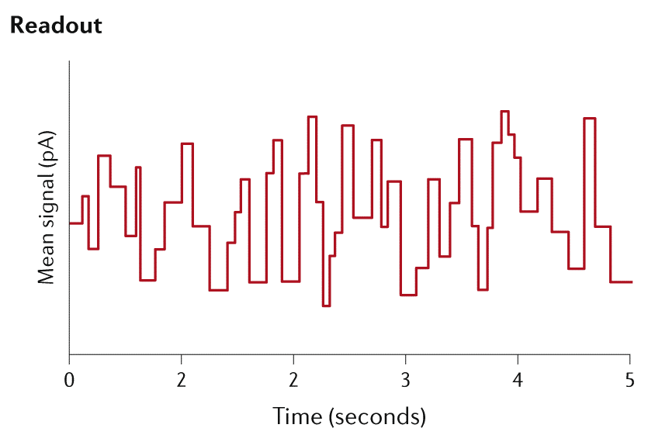
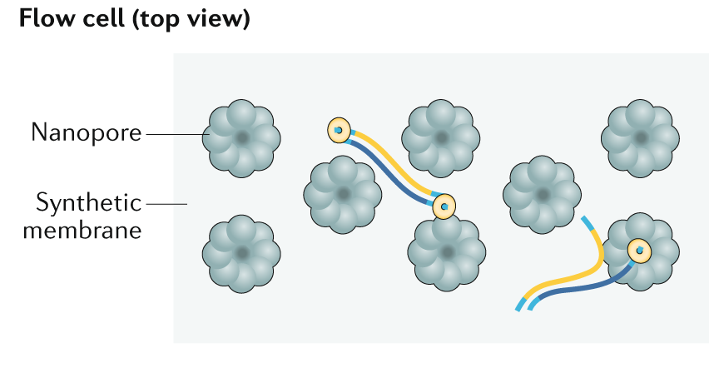
Taxonomic resolution of 16S rRNA sequences
Full-length 16S rRNA sequencing
Oxford Nanopore Technologies (ONT) sequencing
Few studies focusing on clinical samples sequenced with MiniON
Single-molecule per Nanopore
Traditionally high error rates
“Although >99% of reads were correctly classified at the genus level, up to ≈40% were misclassified at the species level. [ONT] constitutes a viable alternative […] for rapid analysis of mixed samples without requiring any culturing steps.”
High error rates on first nanopore models and basecall software (~8-15%) prevented its application for 16S rRNA amplicon sequencing, and was reliable only at the genus level.
Winand et al. 2019. Int. J. of Molecular Sciences, 21(1), 298.

Slide 25
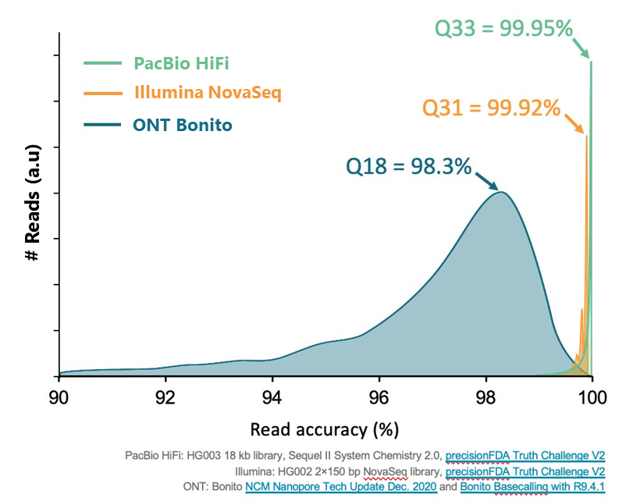
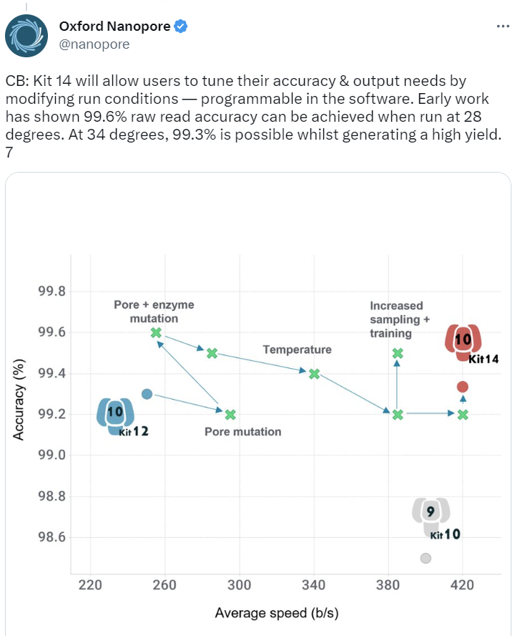
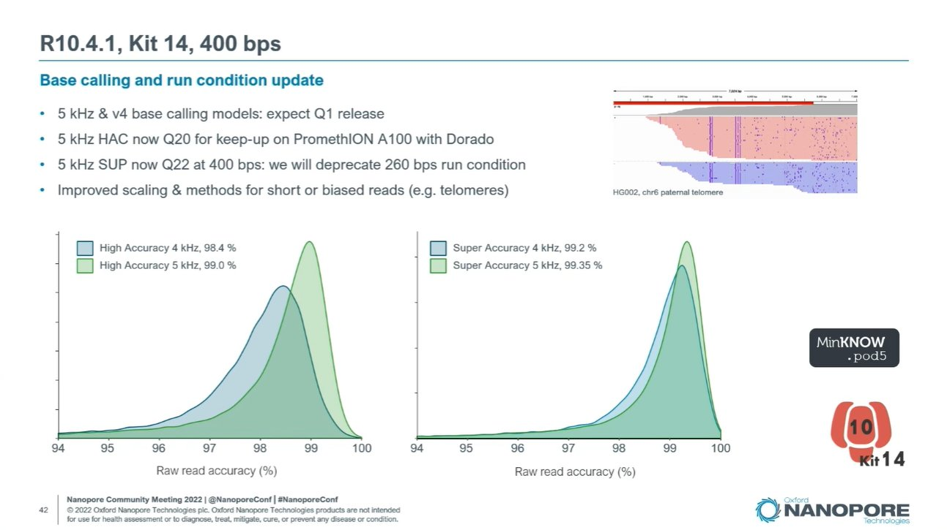

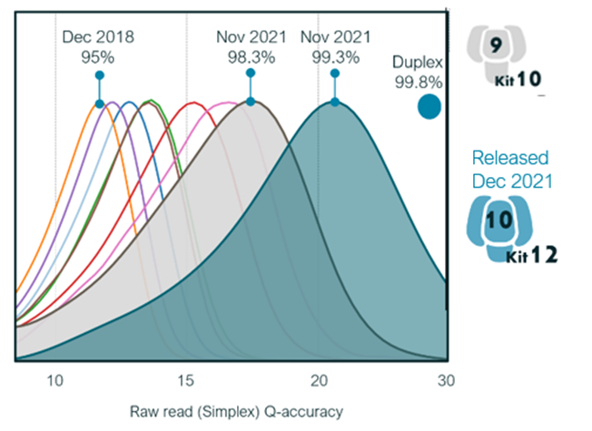
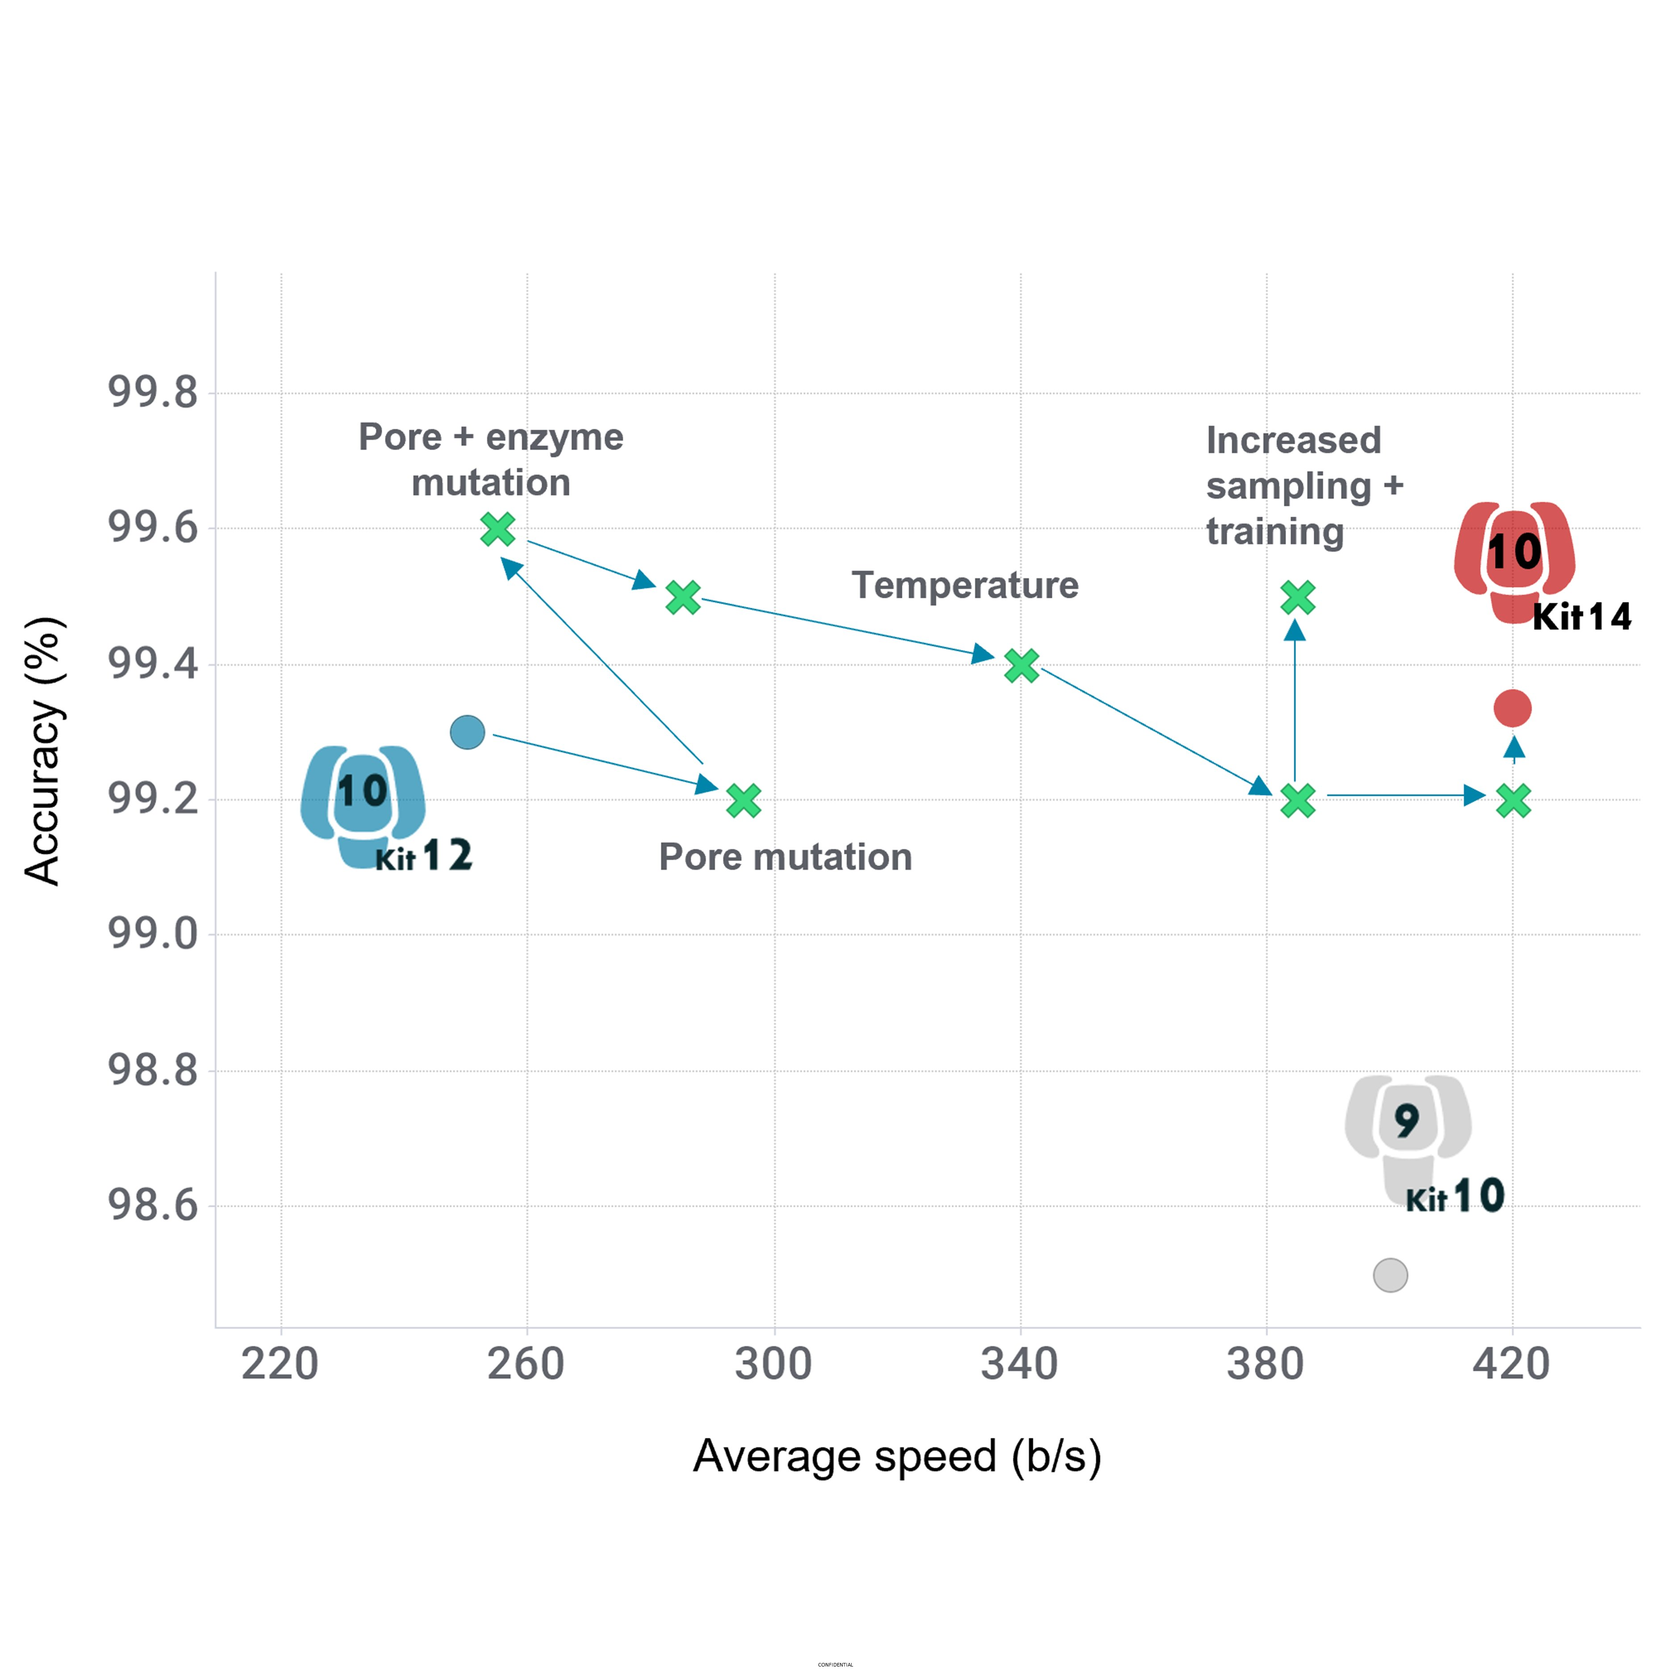
Taxonomic resolution of 16S rRNA sequences
Full-length 16S rRNA sequencing
Oxford Nanopore Technologies (ONT) sequencing
Few studies focusing on clinical samples sequenced with MiniON
Single-molecule per Nanopore
Traditionally high error rates
Latest developments in nanopores, reagents and basecall software are reducing ONT error rates: but still <Q24 (accuracy of 99.6%)!

Slide 26
Analysis of 16S rRNA amplicon sequences

Slide 27
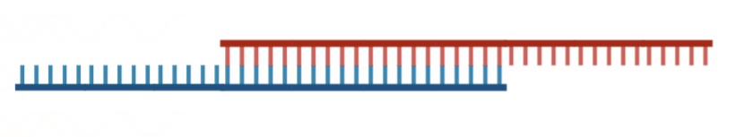
Analysis of 16S rRNA amplicon sequences
Analysis of 16S rRNA amplicon sequences
Metagenome
Who is there?
Targeted metagenomics
16S rRNA amplicon sequencing
Forward read
Reverse read
16S rRNA amplicon sequences after processing

Slide 28
Analysis of 16S rRNA amplicon sequences
16S rRNA amplicon sequences after processing
Seq. no.
Relative abundance
Analysis of 16S rRNA amplicon sequences
Amplicon sequencing data is compositional data. The number of sequences belonging to a specific taxa are proportional to the relative abundance of that taxa
Individual 1
20
31.25%
Individual 2
12
18.75%
Individual 3
4
6.25%
Individual 4
4
6.25%
Individual 5
12
18.75%
Total community:
64 individuals
Individual 6
8
12.5%
Individual 7
4
6.25%
Total
64
100%

Slide 29
Analysis of 16S rRNA amplicon sequences
16S rRNA amplicon sequences after processing
Seq. no.
Relative abundance
Analysis of 16S rRNA amplicon sequences
Amplicon sequencing data is compositional data. The number of sequences belonging to a specific taxa are proportional to the relative abundance of that taxa
Individual 1
5
31.25%
Relative abundance
Absolute abundance
Individual 2
3
18.75%
Individual 3
1
6.25%
Individual 4
1
6.25%
Individual 5
3
18.75%
Individual 6
2
12.5%
Individual 7
1
6.25%
Total
16
100%
Amplicon sequencing does not inform about the real amount of bacteria present in a sample
Total community:
16 individuals

Slide 30

Analysis of 16S rRNA amplicon sequences
16S rRNA amplicon sequences after processing
Analysis of 16S rRNA amplicon sequences
Individual 1
Real diversity
Individual 2
Species a
Individual 3
Species b
Individual 4
Individual 5
Species c
Individual 6
Individual 7
Species d

Slide 31

Analysis of 16S rRNA amplicon sequences
16S rRNA amplicon sequences after processing
Analysis of 16S rRNA amplicon sequences
During 16S rRNA sequencing and processing, errors are introduced
Individual 1
Real diversity
Sequence errors
Sequence errors
Species a
Species b
Individual 2
Individual 3
Species c
Individual 4
Individual 5
Species d
Individual 6
Individual 7

Slide 32
Analysis of 16S rRNA amplicon sequences
Analysis of 16S rRNA amplicon sequences
Operational Taxonomic Units (OTUs) clustering
Strategies for analyzing 16S rRNA amplicon sequences
OTU 1
Real diversity
Sequence errors
OTU 3
Species a
Species b
OTU 2
Species c
Amplicon Sequence Variants (ASVs)
Q=39
ASV2
Q=22
Q=20
ASV1
ASV3
Species d
Q=20
Q=15
Q=35
Q=15
Q=22
ASV5
Q=40
Q=20
ASV4
Q=5
ASV6
Q=37
Q=39
Q=35
Q=20
Q=15
Q=28
ASV7

Slide 33
Analysis of 16S rRNA amplicon sequences
Sequencing errors are avoided by clustering sequences into OTUs
Arbitrary clustering threshold (99%, 98%, 97%, 95%...)
Underestimation of diversity
Sequencing artifacts are retained in the analysis
Analysis of 16S rRNA amplicon sequences
Operational taxonomic units (OTUs) clustering
Real diversity
Sequence errors
Clustering at 97% seq. identity
OTUs
Species a
OTU 1
Species b
OTU 3
Species c
Species d
OTU 2

Slide 34

Analysis of 16S rRNA amplicon sequences
Analysis of 16S rRNA amplicon sequences
Amplicon sequence variants (ASVs)
Callahan et al. High-resolution sample inference from Illumina amplicon data. 2016. Nature methods, 13(7), 581-583
Real diversity
Sequence errors
Model error rates
Species a
Species b
Q=39
Q=22
Q=20
Q=20
Q=15
Q=35
Species c
Q=15
Q=22
Q=40
Q=20
Q=5
Q=37
Q=39
Q=35
Q=20
Q=15
Q=28
Species d
Based on our ability to identify and remove error-containing sequences

Slide 35
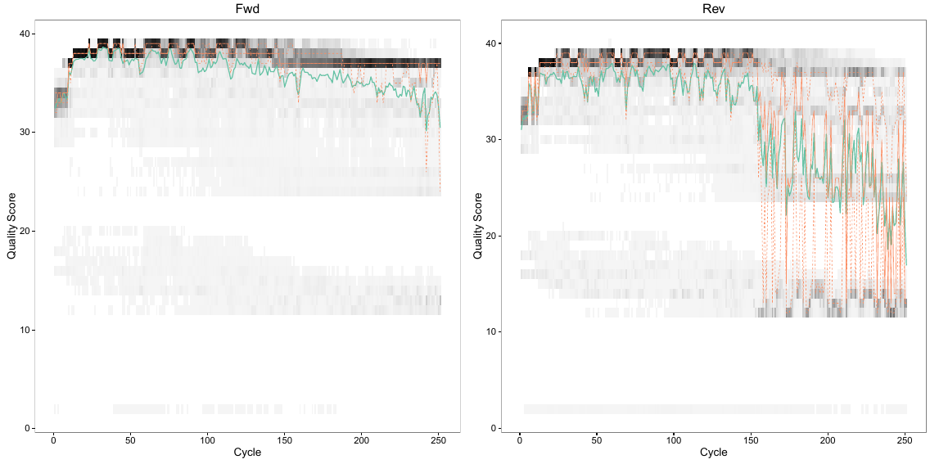
Analysis of 16S rRNA amplicon sequences
Model error rates
Analysis of 16S rRNA amplicon sequences
Q=39
Amplicon sequence variants (ASVs)
Q=22
Q=20
Errors are independent events
Errors depend on the base-pair Q-score
Q=35
Q=20
Q=15
Q=15
Q=22
Q=40
Q=20
Q=5
Q=37
Q=39
Q=35
Q=20
Q=15
Q=28
Each read orientation has independent error profiles
More accurate models are generated with larger amount of data, but really bad quality reads reduce model accuracy

Slide 36
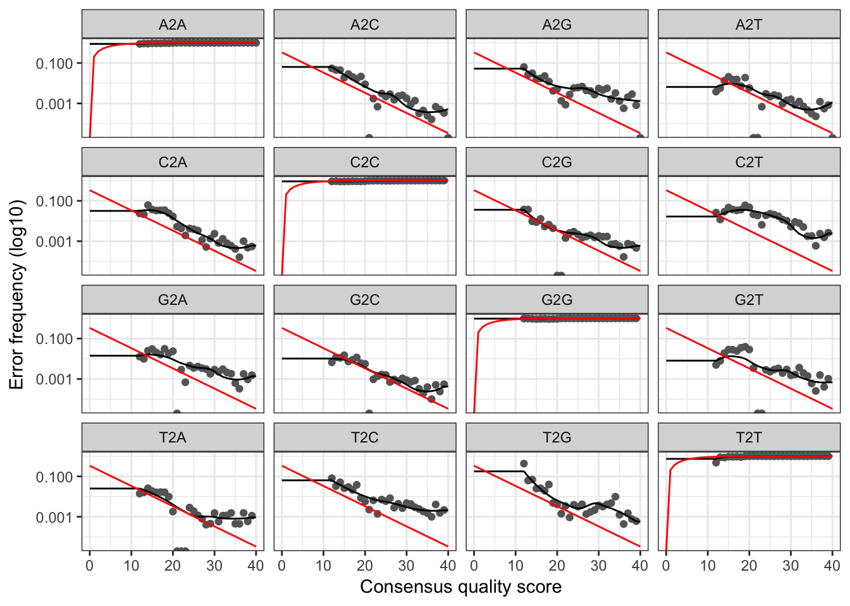
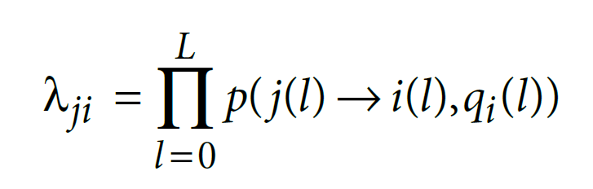
Analysis of 16S rRNA amplicon sequences
Model error rates
Analysis of 16S rRNA amplicon sequences
Q=39
Amplicon sequence variants (ASVs)
Q=22
Q=20
Errors are independent events
Errors depend on the base-pair Q-score
Error transitions can be modeled
Error rates are learnt (modeled) as a function of sequencing quality score
Q=35
Q=20
Q=15
Q=15
Q=22
Q=40
Q=20
Q=5
Q=37
Q=39
Q=35
Q=20
Q=15
Q=28
What are the chance of generating a sequence with error?
The probability of generating a sequence i with an error from real sequence j equals the product of per-site probability of transition.
The transition probability depends on
The original base
The substituting base
The quality score
The error rates for each possible transition (A→C, A→G, …) are shown. Points are the observed error rates for each consensus quality score. The black line shows the estimated error rates after convergence of the machine-learning algorithm. The red line shows the error rates expected under the nominal definition of the Q-score.

Slide 37
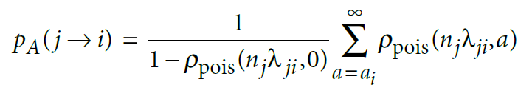
Analysis of 16S rRNA amplicon sequences
Model error rates
Analysis of 16S rRNA amplicon sequences
Q=39
Amplicon sequence variants (ASVs)
Q=22
Q=20
Errors are independent events
Errors depend on the base-pair Q-score
Error transitions can be modeled
Q=35
Q=20
Q=15
Q=15
Q=22
Q=40
Q=20
Q=5
If errors are independent between and within reads, and error-containing reads originate from real reads…
we can model their expected abundances
Error-containing reads will always be less abundant than real reads
The expected abundance of an error-containing sequence i follows a Poisson distribution and is equal to the error rate (λ_{ji}) multiplied by the expected reads of a sample sequence j.
We can calculate a p-value (probability of seen and error-containing sequence i) with an abundance ≥ than the observed value by chance, given the abundance of parent sequence j.
A low p_{A}(j→i) means the abundance of sequence i cannot be explained by errors during amplification and sequencing of n_{j} copies → therefore i is a true ASV
Q=37
Q=39
Q=35
Q=20
Q=15
Q=28

Slide 38
Analysis of 16S rRNA amplicon sequences
Most bacteria have multiple 16S rRNA gene copies with SNPs
Inflation in diversity
Very low-quality datasets will overestimate ASVs
Analysis of 16S rRNA amplicon sequences
Amplicon sequence variants (ASVs)
Real diversity
Sequence errors
Model error rates
ASVs
Species a
Species b
Q=39
ASV2
Q=22
Q=20
ASV1
ASV3
Q=20
Q=15
Q=35
Species c
Q=15
Q=22
ASV5
Q=40
Q=20
ASV4
Q=5
ASV6
Q=37
Q=39
Q=35
Q=20
Q=15
Q=28
ASV7
Species d

Slide 39
Analysis of 16S rRNA amplicon sequences
Analysis of 16S rRNA amplicon sequences
Operational Taxonomic Units (OTUs) clustering
Strategies for analyzing 16S rRNA amplicon sequences
OTU 1
Real diversity
Sequence errors
OTU 3
Species a
Species b
OTU 2
Species c
Amplicon Sequence Variants (ASVs)
Q=39
ASV2
Q=22
Q=20
ASV1
ASV3
Species d
Q=20
Q=15
Q=35
Q=15
Q=22
ASV5
Q=40
Q=20
ASV4
Any of the two methods for analyzing 16S rRNA amplicon sequences will produce as output a table with the OTUs/ASVs and their frequency.
Q=5
ASV6
Q=37
Q=39
Q=35
Q=20
Q=15
Q=28
ASV7

Slide 40
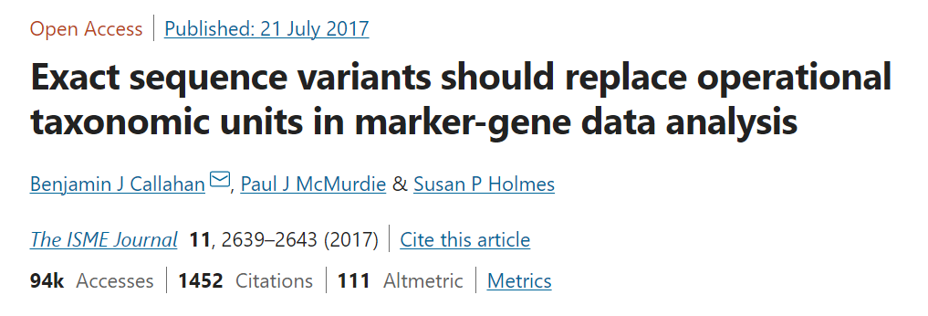
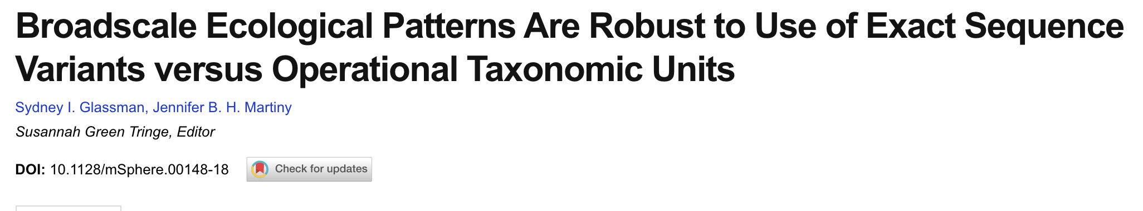
Analysis of 16S rRNA amplicon sequences
OTUs vs. ASVs
Operational Taxonomic Units (OTUs) clustering
Amplicon Sequence Variants (ASVs)
OTUs
Sequencing errors are avoided by clustering sequences into OTUs
Arbitrary clustering threshold (99%, 98%, 97%, 95%...)
Underestimation of diversity
Sequencing artifacts are retained in the analysis
ASVs
Most bacteria have multiple 16S rRNA gene copies with SNPs → inflation in diversity
Very low-quality dataset will overestimate ASVs
More resolution than OTUs
Better handling of sequencing errors
OTU 1
ASV2
ASV1
ASV3
OTU 3
ASV4
ASV5
ASV6
OTU 2
ASV7

Slide 41

Analysis of 16S rRNA amplicon sequences
Limitations of 16S rRNA amplicon seq.
Operational Taxonomic Units (OTUs) clustering
Amplicon Sequence Variants (ASVs)
Neither OTUS nor ASVs represent natural biological units; they are just operational
16S rRNA fragment amplicons cannot delineate bacterial species
The 16S rRNA gene cannot inform on bacterial phenotypes/functions
16S rRNA amplicon sequencing does not inform about the real amount of bacteria present in a sample
Bacteria are not the only microbes!
OTU 1
ASV2
ASV1
ASV3
OTU 3
ASV4
ASV5
ASV6
OTU 2
ASV7
Who is there?
Prokaryotes
Archaea
Viruses
Eukaryotes
Nematodes
Protozoa
Fungi
…
Eukaryotic Internal transcribed spacer (ITS) regions
16S rRNA
16S rRNA
?¿
18S rRNA / ITS

Slide 42
Diversity
A brief introduction

Slide 43

Diversity – brief introduction
Scales of diversity
What is (bio)diversity?
β
α
is a measure of the magnitude of genetic, species and ecological variation in an ecosystem.
α
Unit of diversity
Can be species, strains, individuals…
Real diversity
β
Species a
β
Species b
Species c
α
α
β
Species d
The total diversity within a landscape is called Gamma diversity,
and consist of two components:
… the local variation contained in each site or sample, or Alpha diversity…
… and the degree of dissimilarity between sites (turnover), known as Beta diversity.
γ = α · β

Slide 44
Diversity – brief introduction
Scales of diversity
What is (bio)diversity?
α
is a measure of the magnitude of genetic, species and ecological variation in an ecosystem.
α
Unit of diversity
Can be species, strains, individuals…
ASVs / OTUs
Real diversity
Species a
ASV2
ASV1
Species b
ASV3
ASV5
Species c
α
α
ASV4
ASV6
Species d
ASV7
The total diversity within a landscape is called Gamma diversity,
and consist of two components:
… the local variation contained in each site or sample, or Alpha diversity…
… and the degree of dissimilarity between sites (turnover), known as Beta diversity.

Slide 45
Diversity – brief introduction
Alpha diversity
Is the community diversity within a single sample.
Richness: The number of ASVs/OTUs present
Evenness: The relative abundance of each ASVs/OTUs
Sample diversity
Sample 2
Sample 3
Sample 4
Species a
Species b
Evenness
Species c
100
75
100
100
100
Species d
Relative abundance (%)
50
75
75
75
25
Richness = 2 ASVs
50
Richness = 7 ASVs
Richness = 3 ASVs
Richness = 3 ASVs
50
50
0
25
25
25
0
0
0

Slide 46


Diversity – brief introduction
Alpha diversity
Is the community diversity within a single sample.
Richness: The number of ASVs/OTUs present
Evenness: The relative abundance of each ASVs/OTUs
Covered later
in SAGE II
Sample diversity
Different methods (indexes) for estimating Alpha diversity
Simpson Index
Shannon Index
Faith’s Phylogenetic diversity
Pielou’s eveness
…
Evenness
Species a
100
Species b
75
Species c
50
Relative abundance (%)
25
Simpson Index
Shannon Index
Species d
Richness = 7 ASVs
0

Slide 47


Diversity – brief introduction
Beta diversity
Is the degree of dissimilarity between samples.
Beta diversity is often measured in coefficients of dissimilarity or distances, to represent how different communities are in terms of composition or structure.
Distance matrix
Species matrix
 | Sample A | Sample B | Sample C
Sample A | 1 | 0.25 | 0.33
Sample B | 0.25 | 1 | 0.24
Sample C | 0.33 | 0.24 | 31
 | Sample A | Sample B | Sample C
Species a | 100 | 80 | 50
Species b | 12 | 10 | 20
Species c | 20 | 40 | 30
Species d | 12 | 0 | 15
Species e | 0 | 18 | 20
Sample A
Sample B
Species a
Species e
Species b
Species a
Species b
Species c
Species c
Species d
Bray-Curtis dissimilarity index:
C_{ij} = Sum of the lesser values of the shared species
S_{x} = Total species in S_{x}

Slide 48




Diversity – brief introduction
Beta diversity
Is the degree of dissimilarity between samples.
Beta diversity is often measured in coefficients of dissimilarity or distances, to represent how different communities are in terms of composition or structure.
Dissimilarity matrices are multidimensional, and need multivariate statistics to test and project
Distance matrix
 | Sample A | Sample B | Sample C
Sample A | 1 | 0.25 | 0.33
Sample B | 0.25 | 1 | 0.24
Sample C | 0.33 | 0.24 | 31
Covered later
in SAGE II
Ordination analyses
Association networks
Clustering analyses
Bray-Curtis dissimilarity index:
C_{ij} = Sum of the lesser values of the shared species
S_{x} = Total species in S_{x}

Slide 49
Examples

Slide 50




Examples
“a systematic attempt to characterize global microbial taxonomic and functional diversity for the benefit of the planet and humankind”
https://earthmicrobiome.org/
Figure 1 | Environment type and provenance of samples. a, The EMP ontology (EMPO) classifies microbial environments (level 3) as free-living or host-associated (level 1) and saline or non-saline (if free-living) or animal or plant (if host-associated) (level 2). The number out of 23,828 samples in the QC-filtered subset in each environment is provided. EMPO is described with examples at http://www.earthmicrobiome.org/protocolsand-standards/empo. b, Global scope of sample provenance: samples come from 7 continents, 43 countries, 21 biomes (ENVO), 92 environmental features (ENVO), and 17 environments (EMPO).

Slide 51


Examples
299 fecal samples
Collected during 1 year
~360 OTUs (97% Id)
Robust, but subtle changes
Living abroad or illness cause perturbations

Slide 52



Examples
Seeds
Leaf
endosphere
Stem endosphere
Root endosphere
Rhizosphere
soil
Rhizosphere microbiome influences the plant growth and health – effects on agriculture: crop yield
Bulk soil
Distribution of bacteria (16S rRNA amplicons) and fungi (18S rRNA amplicons) OTUs across plant tissues and over the plant life (from seed to seed).
Vertically transmitted OTUs dominate seed microbial communities during seed maturation

Slide 53
SAGE II – Water Kefir samples
Kefir subcultures
Question 2
Dried figs
Raisins
Question 1
Question 3
Dried figs
Raisins
Question 1: How similar are the communities in the two kefir starter cultures?
Question 2: How stable are the communities over time?
Question 3: Do they change in response to the environment?

Slide 54
Notes:
This bring us to what is often referred as the great plate count anomaly.

